Slide 1
TENNESSEE COUNTY ATTORNEY ASSOCIATION SPRING CONFERENCE Presented by Laura Chastain Ethics Counsel Board of Professional Responsibility April 29, 2022

Slide 2
WORKING REMOTELY
ETHICAL ISSUES FACING COUNTY ATTORNEYS

Slide 3
REMEMBER THE ETHICS HOTLINE IS THE PLACE TO GO WHEN YOU HAVE QUESTIONS ABOUT THE ETHICS OF A SITUATION IN WHICH YOU FIND YOURSELF
This Photo by Unknown Author is licensed under CC BY-SA-NC

Slide 4
When giving ethics opinions, ethics counsel is prohibited from giving ethics opinions by board policy in the following situations:
1. A LEGAL QUESTION;
2. MATTERS PENDING BEFORE A COURT OR ADMINISTRATIVE BODY;
3. ANOTHER LAWYER’S CONDUCT;
4. YOUR OWN PAST CONDUCT.

Slide 5
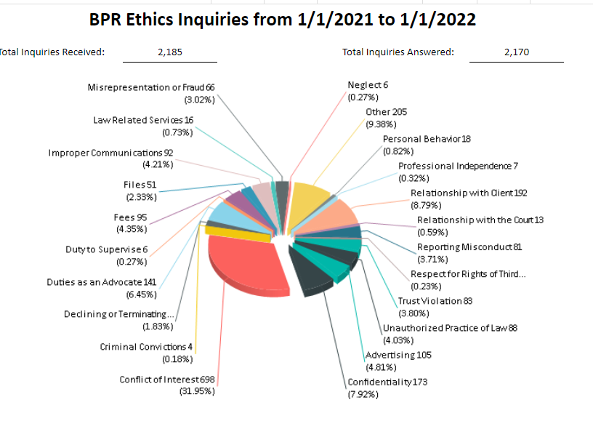
WORKING REMOTELY
CONFLICTS OF INTEREST
LARGEST NUMBER OF INQURIES IN 2021

Slide 6
WORKING REMOTELY
GOVERNMENT LAWYERS ARE OFTEN FACED WITH CONFLICT OF INTEREST ISSUES THAT DO NOT EXIST IN NON-GOVERNMENTAL SERVICE
RPC SCOPE COMMENT [19]
“Under various legal provisions, including constitutional, statutory, and common law, the responsibilities of government lawyers may differ from those of lawyers in private client-lawyer relationships. Certain government lawyers may be authorized to represent several government agencies, officers, or employees in legal controversies in circumstances where a private lawyer could not represent multiple private clients.”

Slide 7
ENABLING AUTHORITY
MOST GOVERNMENT LAWYER’ S OBLIGATIONS AND DUTIES ARE SET FORTH IN THEIR ENABLING AUTHORITY BY STATUTE OR CHARTER.

Slide 8
LEGISLATURE HAS NOT CREATED THE OFFICE OF COUNTY ATTORNEY AS A GENERAL LAW APPLICABLE TO ALL COUNTIES
IN COUNTIES HAVING A POPULATION OF LESS THAN 400,000 THAT ADOPT THE COUNTY MANAGER FORM OF GOVERNMENT ARE REQUIRED TO HAVE A COUNTY ATTORNEY, BUT THERE IS NO SUCH REQUIREMENT OF OTHER COUNTIES. THE DUTIES OF COUNTY ATTORNEYS DESCRIBED IN THE STATUTE APPLICABLE TO COUNTIES WHO ADOPT THE MANAGER FORM OF GOVERNMENT MIGHT OR MIGHT NOT INCLUDE REPRESENTING THE SHERIFF AND HIS DEPUTIES.
T.C.A. 5-15-305

Slide 9
NOT ALL TENNESSEE COUNTIES HAVE A COUNTY ATTORNEY
T.C.A. 5-6-112 SETS OUT THE POWERS AND DUTIES OF COUNTY EXECUTIVES AND PROVIDES: “IF THERE BE NO COUNTY ATTORNEY”, THE COUNTY EXECUTIVE MAY EMPLOY AN ATTORNEY TO ADVISE HIM AND THE LEGISLATIVE BODY OF THE COUNTY. ADDITIONAL DUTIES ARE LISTED WHICH APPARENTLY WOULD NOT INCLUDE REPRESENTING THE SHERIFF OR HIS DEPUTIES.

Slide 10
SCOPE OF REPRESENTATION
FOR MOST COUNTY ATTORNEYS, THE SCOPE OF REPRESENTATION IS SET OUT IN THE COUNTY CHARTER.

Slide 11
THE FIRST QUESTION TO ASK WHEN TRYING TO DECIDE IF YOU HAVE A CONFLICT IS: WHO IS MY CLIENT ?
WHAT DOES THE AUTHORIZING AUTHORITY SAY?
CHARTER
PUBLIC ACT

Slide 12
“THE IDENTITY OF THE CLIENT IS A CRITICAL THRESHOLD ISSUE, SINCE, AS A CORE PROFESSIONAL PRINCIPLE, THE LAWYER’S PROFESSIONAL DUTIES TO SAFEGUARD HIS OR HER CLIENT’S CONFIDENCES AND TO AVOID CONFLICTS OF INTEREST ARE OWED ONLY TO CLIENTS.”
Richard C. Solomon, Wearing Many Hats: Confidentiality and Conflicts of Interest Issue for the California Public Lawyer, 25 Sw. U.L. REV. 265, 270 (1996)

Slide 13
“INDEED, THE ABA’S MODEL RULES OF PROFESSIONAL CONDUCT FOR LAWYERS RECOGNIZE THAT, IN THE GOVERNMENT CONTEXT, CLIENT IDENTIFICATION AND THE RESULTING OBLIGATIONS CAN BE QUITE DIFFICULT TO GAUGE.”
ABA MODEL RULE 1.13 ORGANIZATION AS A CLIENT.
Some Ethical Conundrums for City and County Attorneys, Charles W. Thompson, Jr. Executive Director/General Counsel International Municipal Lawyers Association.

Slide 14
RPC 1.13 ORGANIZATIONAL CLIENTS SETS FORTH GUIDANCE FOR REPRESENTATION OF THE COUNTY/ENTITY.
“A LAWYER EMPLOYED OR RETAINED BY AN ORGANIZATION REPRESENTS THE ORGANIZATION ACTING THROUGH ITS DULY AUTHORIZED CONSTITUENTS.”

Slide 15
RPC 1.7(a) CONFLICT OF INTEREST CURRENT CLIENTS
“EXCEPT AS PROVIDED IN PARAGRAPH (b), A LAWYER SHALL NOT REPRESENT A CLIENT IF THE REPRESENTATION INVOLVES A CONCURRENT CONFLICT OF INTEREST. A CONCURRENT CONFLICT OF INTEREST EXISTS IF:
(1) THE REPRESENTATION OF ONE CLIENT WILL BE DIRECTLY ADVERSE TO ANOTHER CLIENT; OR
(2) THERE IS A SIGNIFICANT RISK THAT THE REPRESENTATION OF ONE OR MORE CLIENTS WILL BE MATERIALLY LIMITED BY THE LAWYER’S RESPONSIBILITIES TO ANOTHER CLIENT, A FORMER CLIENT OR A THIRD PERSON OR BY A PERSONAL INTEREST OF THE LAWYER.

Slide 16
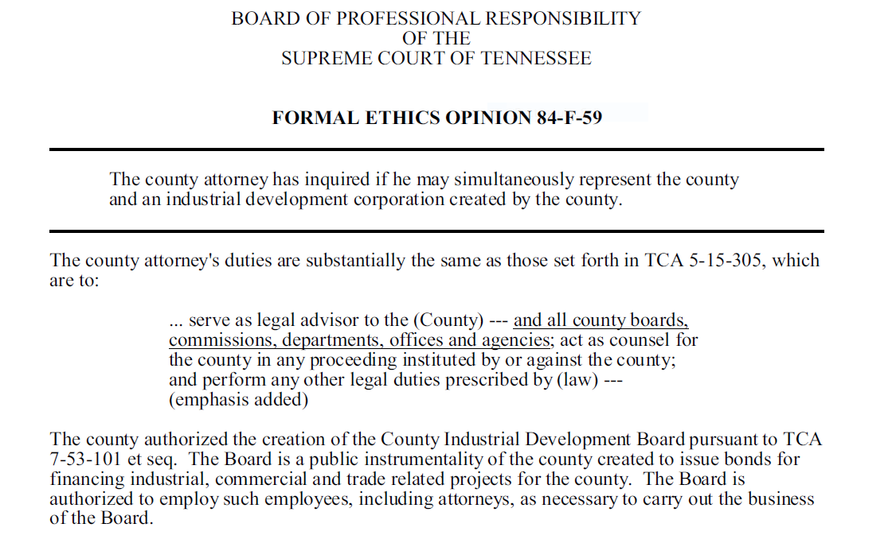
FORMAL ETHICS OPINION 84-F-59

Slide 17
HOW DO YOU RESOLVE THE QUESTION OF WHETHER YOU HAVE A CONFLICT OF INTEREST ?
1. Clearly identify the client or clients;
2. determine whether a conflict of interest exists;
3. decide whether the representation may be undertaken despite the existence of a conflict, i.e. whether the conflict is consentable; and
4. if so, consult with the clients affected under paragraph (a) and obtain their informed consent, confirmed in writing.
RPC 1.7 Comment [2]

Slide 18
RESOLUTION OF A CONFLICT OF INTEREST
COMMENT [2] TO RPC 1.7 STATES:
“Resolution of a conflict of interest problem under this Rule requires the lawyer to: 1) clearly identify the client or clients; 2) determine whether a conflict of interest exists; 3) decide whether the representation may be undertaken despite the existence of a conflict, i.e. whether the conflict is consentable; and 4) if so, consult with the clients affected under paragraph (a) and obtain their informed consent, confirmed in writing. The clients affected under paragraph (a) include both of the clients referred to in paragraph (a)(1) and the one or more clients whose representation might be materially limited under paragraph (a)(2).

Slide 19
CAN A MUNICIPALITY GIVE INFORMED CONSENT ?
ALTHOUGH SOME STATES HOLD THAT A GOVERNMENTAL ENTITY CANNOT GIVE INFORMED CONSENT, TENNESSEE HOLDS THAT A “GOVERNMENT OFFICIAL OR ENTITY, LIKE ANY OTHER CLIENT, MAY WAIVE A CONFLICT OF INTEREST UNDER THIS RULE.”
Tenn. Sup. Ct. Rule 8 RPC 1.7 cmt. (19a).”
PFIZER, INC. and Pharmacia Corp v. Reagan FARR, Commissioner of Revenue, State of Tennessee, 2012 WL 2370619 (Tenn. Ct. App. 2012).

Slide 20
REQUIREMENTS FOR WAIVER OF CONFLICT OR INFORMED CONSENT RPC 1.7(b)
1. THE LAWYER REASONABLY BELIEVES THAT THE LAWYER WILL BE ABLE TO PROVIDE COMPETENT AND DILIGENT REPRESENTATION TO EACH AFFECTED CLIENT;
2. THE REPRESENTATION IS NOT PROHIBITED BY LAW;
3. THE REPRESENTATION DOES NOT INVOLVE THE ASSERTION OF A CLAIM BY ONE CLIENT AGAINST THE OTHER CLIENT REPRESENTED BY THE LAWYER IN THE SAME LITIGATION OR PROCEEDING BEFORE A TRIBUNAL;
4. EACH AFFECTED CLIENT GIVES INFORMED CONSENT, CONFIRMED IN WRITING.

Slide 21
WHAT IS “INFORMED CONSENT” ?

Slide 22
RPC 1.0(e) TERMINOLOGY “INFORMED CONSENT”
“INFORMED CONSENT” DENOTES THE AGREEMENT BY A PERSON TO A PROPOSED COURSE OF CONDUCT AFTER THE LAWYER HAS COMMUNICATED ADEQUATE INFORMATION AND EXPLANATION ABOUT THE MATERIAL RISKS OF AND REASONABLY AVAILABLE ALTERNATIVES TO THE PROPOSED COURSE OF CONDUCT.

Slide 23
WHAT SHOULD THE LAWYER CONSIDER IN OBTAINING “INFORMED CONSENT” ?
1. HAVE A SEPARATE VERBAL COMMUNICATION WITH EACH CLIENT AND CLEARLY IDENTIFY EACH CLIENT TO THE OTHER AND ADVISE EACH CLIENT OF YOUR RELATIONSHIPS WITH THE OTHER.
2. INCLUDE IN YOUR COMMUNICATION A DISCUSSION THAT IS IN SIMPLE TERMS TO ASSURE THAT THE CLIENT UNDERSTANDS ALL OF THE ISSUES.

Slide 24
WHAT SHOULD THE LAWYER CONSIDER IN OBTAINING “INFORMED CONSENT” ?
3. ASK CLIENTS IF THEY HAVE ANY QUESTIONS ABOUT THESE MATTERS.
4. ANSWER ALL OF THEIR QUESTIONS.

Slide 25
WHAT SHOULD THE LAWYER CONSIDER IN OBTAINING “INFORMED CONSENT” ?
5. ADVISE THE CLIENTS THAT YOU WILL BE SENDING THEM A LETTER CONTAINING ALL THE INFORMATION CONTAINED IN YOUR VERBAL EXPLANATION AND THAT YOU WILL NOT BE ABLE TO PROCEED WITHOUT RECEIVING THEIR VERBAL CONSENT, TO BE FOLLOWED UP BY THEIR INFORMED WRITTEN CONSENT.
6. DESCRIBE THE CIRCUMSTANCES THAT CREATE A CONFLICT.

Slide 26
WHAT SHOULD THE LAWYER CONSIDER IN OBTAINING “INFORMED CONSENT” ?
7. ADVISE THE CLIENT OF THE SERIOUSNESS OF THE DECISION SO AS TO AVOID DISPUTES OR AMIBIGUITIES THAT MIGHT LATER OCCUR.
8. ADVISE EACH CLIENT THAT ONCE THEY GIVE THEIR CONSENT, THEY MAY LATER REVOKE IT, AND LIKE ANY OTHER CLIENT, TERMINATE YOUR REPRESENTATION AT ANYTIME

Slide 27
WHAT SHOULD THE LAWYER CONSIDER IN OBTAINING “INFORMED CONSENT” ?
10. OBTAIN CLIENTS’ INFORMED CONSENT IN WRITING.
9. SUGGEST THAT EACH CLIENT SEEK INDEPENDENT LEGAL ADVICE AND GIVE THE CLIENTS OPPORTUNITY TO SEEK SUCH ADVICE.

Slide 28
MANY COUNTY ATTORNEYS ARE ALSO IN PRIVATE PRACTICE.
RPC 1.11 (d) SHOULD BE CONSULTED WITH REGARD TO CONFLICTS INVOLVING THEIR PRIVATE PRACTICE CONFLICTS:
“A LAWYER SERVING AS A PUBLIC OFFICER OR EMPLOYEE:
(1) IS SUBJECT TO RPC’S 1.7 AND 1.9; AND
(2) SHALL NOT:
(i) PARTICIPATE IN A MATTER IN WHICH THE LAWYER PARTICIPATED PERSONALLY AND SUBSTANTIALLY WHILE IN PRIVATE PRACTICE OR NONGOVERNMENTAL EMPLOYMENT, UNLESS THE APPROPRIATE AGENCY GIVES ITS INFORMED CONSENT, CONFIRMED IN WRITNG, OR UNDER APPLICABLE LAW NO ONE IS, OR BY LAWFUL DELEGATION MAY BE, AUTHORIZED TO ACT IN THE LAWYER’S STEAD IN THE MATTER….”

Slide 29
TENNESSEE OPEN MEETINGS ACT

Slide 30
OPEN MEETINGS ACT
“GOVERNMENT LAWYERS IN TENNESSEE ARE ALSO SUBJECT TO THE OPEN MEETINGS ACT AS INTERPRETED BY THE TENNESSEE COURTS.”
RPC SCOPE COMMENT [19]

Slide 31
STATEMENT OF PURPOSE
“The general assembly hereby declares it to be the policy of this state that the formation of public policy and decisions is public business and shall not be conducted in secret.”

Slide 32
TENNESSEE OPEN MEETINGS ACT TCA 8-44-101
The law says that actions taken at a meeting in violation of the Open Meetings Act “shall be void and of no effect…” TCA 8-44-105. The Act also given the courts jurisdiction to “issue injunctions, impose penalties and otherwise enforce the purposes” of the Act if a citizen files a lawsuit.

Slide 33
“ADEQUATE PUBLIC NOTICE”
In order to meet the requirements of the Open Meetings Act, “Adequate Public Notice” must be given before all meeting to which the Act applies. TCA 8-44-103.

Slide 34
Tennessee Court of Appeals Three Prong Test for “Adequate Public Notice”:
1. Notice must be posted in a location where a member of the community could become aware of the notice,
2. The contents of the notice must reasonably describe the purpose of the meeting or the action to be taken, and
3. The notice must be posted at a time sufficiently in advance of the meeting to give citizens an opportunity to become aware of the meeting and to attend.
Englewood Citizens for Alternate B v. Town of Englewood, 199 WL 419710 (Tenn, Ct. App. 1999).

Slide 35
THE REQUIREMENTS OF THE OPEN MEETINGS LAW ARE IN ADDITION TO ANY OTHER NOTICE REQUIRED BY LAW
Example: Meetings of county legislative bodies, are also governed by the provisions of TCA 5-5-104 and TCA 5-5-105 which require regular meetings to be set by resolution of the county legislative body, and special called meetings require newspaper notice at least five days prior to the meeting that contains the agenda for the meeting.

Slide 36
IF THE OPEN MEETINGS ACT IS VIOLATED:
Any citizen of the state may bring an action against a public body in violation of the law. Any action taken during a meeting in violation of the Open Meetings Act is considered void.
The enforcement of the Open Meetings Act has been left to citizens and the press through lawsuits in local Chancery and Circuit courts.

Slide 37
KNOX COUNTY OPEN MEETINGS VIOLATION LED TO A JURY TRIAL
In 2007 several Knox County Commissioners deliberated privately before voting to fill eight vacancies on the Commission and 4 vacant countywide offices, including the Sheriff.
After a two week jury trial, the judge accepted the jury’s verdict and removed all 12 officials from office.

Slide 38
OCTOBER 8, 2020 TN JUDGE RULED CAMPAIGN FINANCE AGENCY’S EMAIL VOTE VIOLATED OPEN MEETINGS ACT.
Chancellor Ellen Hobbs Lyle issued a written order granting final judgment in favor of plaintiffs in Associated Press v. Tennessee Registry of Election Finance. The Registry “violated the spirit and requirements of the [Open Meetings Act] by deciding via an email vote whether to recommend settlement with Representative [Joe] Towns.”

Slide 39
OPEN MEETINGS VIOLATIONS CAN BE CURED.
A governing body that violates the Open Meetings Act can “cure” that violation by “new and substantial” reconsideration of their actions, essentially doing it over by following the law. Neese v. Paris Special School District (Ct. App. 1990).
The Court found that the school board deliberated on a rezoning plan in violation of the Open Meetings Act (at a retreat), but that the school board’s eventual vote in public was legal.
The school board scheduled a public meeting, gave adequate notice and then allowed a three-hour public question and answer session on the issue. The Court found that these actions fixed the violation.

Slide 40
EXECUTIVE SESSIONS
The only executive sessions the act mentions are designed to protect attorney-client privilege/litigation, exemptions under federal law and doctor-patient confidentiality.

Slide 41
ETHICS UPDATE 2022
THE LAST YEAR HAS BROUGHT MANY CHANGES TO THE ETHICS RULES AND THE RULES OF DISCIPLINARY ENFORCEMENT

Slide 42
ADVERTISING RULES HAVE CHANGED
This Photo by Unknown Author is licensed under CC BY-SA

Slide 43
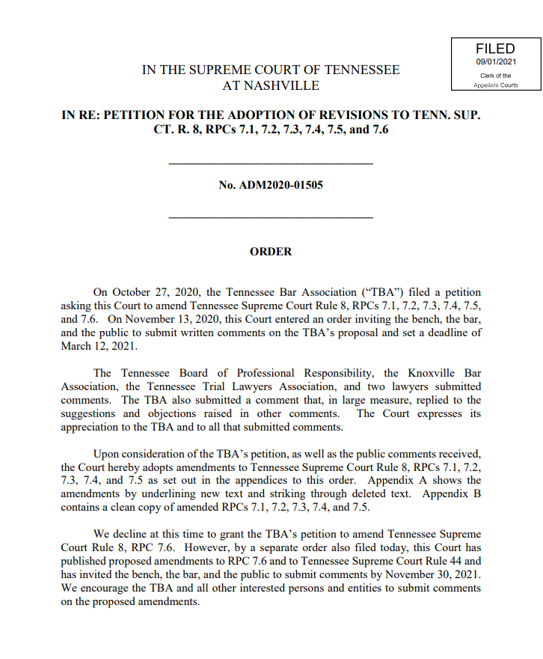
TN SUPREME COURT ORDER 9/01/21

Slide 44
ADVERTISING RULES AMENDED
THE COURT CONSOLIDATED RPC 7.1 AND 7.2 INTO RPC 7.1(a)(b)(c).
NEW RULE 7.1 COMMUNICATIONS CONCERNING A LAWYER’S SERVICES
(a) A lawyer shall not make a false or misleading communication about the lawyer or the lawyer’s services. A communication is false or misleading if it contains a material misrepresentation of fact or law, or omits a fact necessary to make the statement considered as a whole not materially misleading.
(b) Subject to the requirements of paragraph (a) above and RPC’s 7.3 and 7.6, a lawyer may advertise services through written, recorded, or electronic communications, including public media. Any communication made under this Rule shall include the name and contact information of at least one lawyer or law firm responsible for its content.
(c) A Copy or recording of each advertisement shall be retained by the lawyer for two years after its last dissemination along with a record of when and where the advertisement appeared.
TN SUPREME COURT ORDER FILED 9-1-2021

Slide 45
RPC’S 7.2, 7.4, and 7.5 DELETED
AREA OF EXPERTISE/SPECIALIZATION
FIRM NAMES
RECORD OF ADVERTISING
MOVED TO COMMENTS UNDER RULE 7.1

Slide 46
RPC 7.3 SOLICITATION DELETED AND REPLACED
SOLICITATION
(a) A solicitation is a targeted communication initiated by or on behalf of a lawyer that is directed to a specific person and that offers to provide, or reasonably can be understood as offering to provide, legal services or a particular matter.
(b) A lawyer shall not solicit by live person to person contact, or permit employees or agents of the lawyer to solicit by live person to person contact on the lawyer’s behalf, professional employment from a potential client when a significant motive for doing so is the lawyer’s pecuniary gain, unless the person contacted:
(1) is a lawyer; or
(2) is a person who routinely uses for business purposes the type of legal services offered by the lawyer;
(3) is pursuant to a court-ordered class action notification; or
(4) has a family, close personal, or prior professional relationship with the lawyer.

Slide 47
RPC 7.3 SOLICITATION DELETED AND REPLACED
SOLICITATION
(a) A solicitation is a targeted communication initiated by or on behalf of a lawyer that is directed to a specific person and that offers to provide, or reasonably can be understood as offering to provide, legal services or a particular matter.
(b) A lawyer shall not solicit by live person to person contact, or permit employees or agents of the lawyer to solicit by live person to person contact on the lawyer’s behalf, professional employment from a potential client when a significant motive for doing so is the lawyer’s pecuniary gain, unless the person contacted:
(1) is a lawyer; or
(2) is a person who routinely uses for business purposes the type of legal services offered by the lawyer;
(3) is pursuant to a court-ordered class action notification; or
(4) has a family close personal, or prior professional relationship with the lawyer.

Slide 48
LIMITATION ON SOLICITATION RPC 7.3 (d)
(d) A lawyer shall not solicit professional employment from any person if:
(1) the target of the solicitation has made known to the lawyer a desire not to be solicited by the lawyer; or
(2) the solicitation involves coercion, duress, fraud, harassment, intimidation, overreaching, or undue influence; or
(3) a significant motive for the solicitation is the lawyer’s pecuniary gain and the communication concerns an action for personal injury, divorce or legal separation, worker’s compensation, wrongful death, or otherwise relates to an accident, filing of divorce or legal separation, or disaster occurred more than thirty (30) days prior to the mailing or transmission of the communication or the lawyer has a family, close person, or prior professional relationship with the person solicited.

Slide 49
RECORD RETENTION RPC 7.3(e)
(e) A copy of each written, audio, video or electronically transmitted communication sent to a specific recipient under this Rule shall be retained by the lawyer for two years after its last dissemination along with a record of when, and to whom, it was sent.

Slide 50
PAYING OTHERS TO RECOMMEND A LAWYER RPC 7.3(f)
(f) A lawyer shall not compensate, give or promise anything of value to a person who is not an employee or lawyer in the same law firm for the purpose of recommending or securing the services of the lawyer or the lawyer’s law firm, except that a lawyer may:
(1) pay the reasonable cost of advertisements and other communications permitted by RPC 7.1 including online group advertising:
(2) pay the usual charges of a registered intermediary organization as permitted by RPC 7.6;
(3) may pay for a law practice in accordance with RPC 1.17;
(4) pay a sponsorship fee or a contribution to a charitable or other non-profit organization in return for which the lawyer will be given publicity as a lawyer; and
(5) refer clients to another lawyer or nonlawyer professional pursuant to an agreement not otherwise prohibited under these Rules that provides for the other person to refer clients or customers to the lawyer; if;
(i) the reciprocal referral agreement is not exclusive; and
(ii) the client is informed of the existence and nature of the agreement.

Slide 51
RPC 7.4 DELETED AREA OF EXPERTISE/ SPECIALIZATION MOVED TO COMMENTS [9]-[10] UNDER RPC 7.1
SUMMARY
Lawyers may advertise areas of practice, but cannot communicate that the lawyer is a specialist in a particular field unless the lawyer has been certified by an organization accredited by the American Bar Association’s House of Delegates and has registered that certification with the Tennessee Commission on Continuing Legal Education in accordance with TN Supreme Court Rule 21. Lawyers shall not state or imply that the lawyer has received any certification of specialty from the Tennessee Commission on Continuing Legal Education.
ESSENTIALLY THE SAME WORDING

Slide 52
RPC 7.5 FIRM NAMES DELETED MOVED TO COMMENTS [11]-[13] UNDER RPC 7.1
THE COURT MOVED THE SAME WORDING OF THE COMMENTS TO PREVIOUS RULE 7.5 TO COMMENTS [11]-[13] UNDER NEW RULE 7.1.

Slide 53
RULE 7.6 INTERMEDIARY ORGANIZATIONS DELETED AND REPLACED 12/15/21
An Intermediary Organization is a lawyer-advertising cooperative, lawyer referral service, prepaid legal insurance provider, or a similar organization the business or activities of which include the referral of its customers, members, or beneficiaries to lawyers for the performance of fee-generating legal services or the payment for or provision of legal services to the organization’s customers, members, or beneficiaries in matter for which the organization does not bear ultimate responsibility.

Slide 54
RULE 7.6 Continued
A tribunal appointing or assigning lawyers to represent parties before the tribunal or a government agency performing such functions on behalf of a tribunal is not an intermediary organization under this Rule.
(b) Before and while participating in an intermediary organization, a lawyer shall be licensed and in good standing to practice law in Tennessee and shall make reasonable efforts to ensure that the intermediary organization’s conduct complies with the professional obligations of the lawyer, including the following conditions:
1. The intermediary organization does not direct or regulate the lawyer’s professional judgment in rendering legal services to the clients;

Slide 55
RULE 7.6 Continued
2. The intermediary organization, including its agents and employees, does not engage in improper solicitation prohibited by RPC 7.3;
3. The intermediary organization makes the criteria for inclusion available to prospective clients, including any payment made or arranged by the lawyer(s) participating in the service and any fee charged to the client for use of the service at the outset of the client’s interaction with the intermediary organizations.

Slide 56
RULE 7.6 Continued
4. The function of the referral arrangement between lawyer and intermediary organization is fully disclosed to the client at the outset of the client’s interaction with the lawyer;
5. The intermediary organization does not require the lawyer to pay more than a reasonable sum representing a proportional share of the organization’s administrative and advertising costs;
6. The intermediary organization is not owned, controlled, or directed by the lawyer, a law firm with which the lawyer is associated, or a lawyer with whom the lawyer is associated in a firm; and

Slide 57
RULE 7.6 Continued
6. If a lawyer discovers the intermediary organization’s noncompliance with the lawyer’s professional obligations or any of the conditions in paragraph (b), the lawyer shall either withdraw from participation or seek to correct the noncompliance. If the intermediary organization fails to correct the noncompliance, the lawyer must withdraw from participation.

Slide 58
NEW SECTION TO TRUST ACCOUNT RULE

Slide 59
NEW SECTION (f) ADDED TO EXISTING TRUST ACCOUNT RULE 1.15
RPC 1.15(f) A lawyer who learns of unidentified funds in an IOLTA account must make periodic efforts to identify and return the funds to the rightful owner. If after 12 months of the discovery of the unidentified funds the lawyer determines that ascertaining the ownership or securing the return of the funds will not succeed, the lawyer must remit the funds to the Tennessee Lawyers’ Fund for Client Protection (TLFCP). No charge of ethical impropriety or other breach of professional conduct shall attend to a lawyer’s exercise of reasonable judgment under this paragraph (f).

Slide 60
NEW FORM FOR LAWYERS’ FUND FOR CLIENT PROTECTION

Slide 61
1,668 COMPLAINTS FILED LAST YEAR
This Photo by Unknown Author is licensed under CC BY-SA

Slide 63
DISCIPLINE

Slide 65
NEW TENNESSEE SUPREME COURT ORDER REGARDING DISCIPLINARY APPEALS

Slide 66
This Photo by Unknown Author is licensed under CC BY-ND

Slide 68
Proactive Management-Based Regulation (PMBR)
THREE FREE ETHICS CREDITS

Slide 69
THE TEN SELF – ASSESSMENTS FOCUS ON THE TEN CORE PRACTICE PRINCIPLES
1. Developing Competent Practices.
2. Communicating in an Effective, Timely, Professional Manner.
3. Ensuring that Confidentiality Requirements are met.
4. Avoiding Conflicts of Interest.
5. Retaining and Managing Secure Files.
6. Managing the Law Firm/Legal Entity and Staff.
7. Charging Appropriate Fees and Making appropriate Disbursements.
8. Ensuring the Use of Reliable Trust Account Practices.
9. Access to Justice and Client Development; and
10. Promoting Wellness.

Slide 70
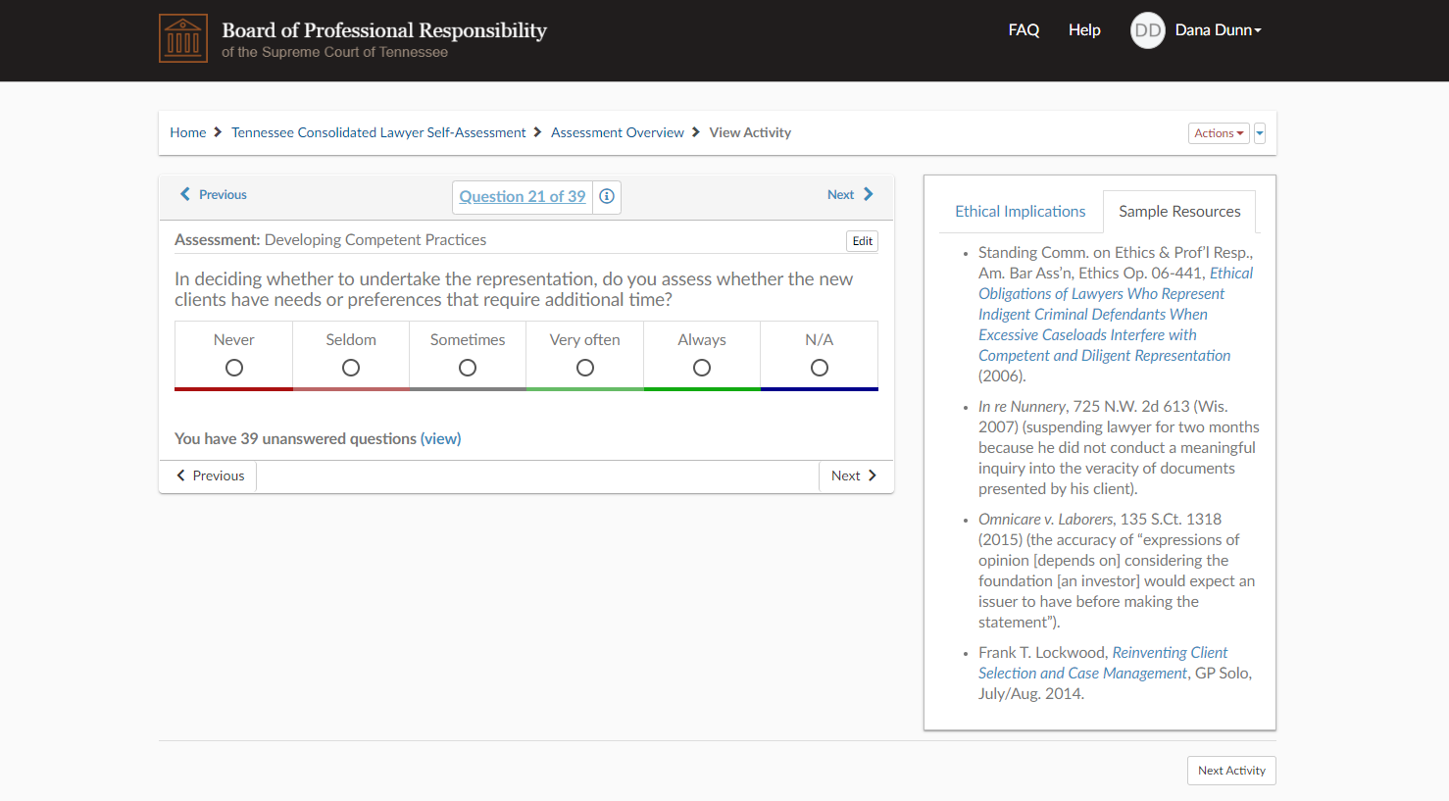

Slide 73
This Photo by Unknown Author is licensed under CC BY-NC-ND

