Slide 1
Dealing With Appeals TCAA 2022 Annual Conference

Slide 2
Property Assessment Appeals In Tennessee
Levels of Appeals in Tennessee
County Board of Equalization (CBOE)
Generally meets in June of each year
State Board of Equalization (SBOE)
Administrative Law Judge (ALJ)
Assessment Appeals Commission (ACC)
SBOE
Court
Chancery Court where property is located
or one of the counties listed in TCA §67-5-1511

Slide 3
How to initiate an appeal
File an appeal with the SBOE (TCA §67-5-1412)
All filings are now made online through the SBOE website
Must have appeared before CBOE first
Some Assessor may waive appearance before CBOE if commercial property

Slide 4
Grounds for Appeal
Property erroneously classified or subclassified
Property has been valued more than market value
Property other than property under appeal
has been valued too low
Property should be exempt

Slide 5
Timeline for filing an appeal
Appeals must be filed with the SBOE by August 1 of the tax year or within 45 days after the notice of CBOE action was sent.
If no CBOE notice sent, within 45 days of tax billing date.
TCA §67-5-1412(e)

Slide 6
SBOE Appeals
There are 8,644 appeals pending before the SBOE – ALJ
Commercial – 7,208
Industrial – 342
Residential 1,107
Farm – 74
Public Utility - 3
46 Appeals Pending before AAC

Slide 7
SBOE Appeals
By year
2014 – 17
2015 – 30
2016 – 35
2017 – 158
2018 – 611
2019 – 1,894
2020 – 922
2021 – 4,977

Slide 8
SBOE Appeals
Appeals Top 5 Counties
Sevier – 3,515
Shelby – 1,840
Davidson – 1,766
Hamilton – 256
Putnam – 225

Slide 9
SBOE Appeals
Appeals by Representative Type
Agent / Attorney – 7,871
Assessor – 115
Self - 658

Slide 10
Rules of SBOE
Rules for Contested Case Procedures
Chapter 0600-01
https://publications.tnsosfiles.com/rules/0600/0600-01.20200810.pdf

Slide 11
Reasonable Cause Hearing
Taxpayer has a right to request a reasonable cause hearing to show why they failed to go to CBOE or failed to file within the timeline
Must file request for reasonable cause hearing by March 1 of year following tax year

Slide 12
Payment of Undisputed Portion of Tax
Must have paid the undisputed portion of the tax prior to the delinquency date.
“Undisputed portion of the tax” is the amount that would be imposed on the basis of the classification and market value claimed on the appeal form.
The tax collecting official may decline to
accept the disputed portion of tax.
TCA § 67-5-1512(b) & Rule 0600-1-.08

Slide 13
Procedure of Appeal
Discovery
Rules of Civil Procedure
Rules of Evidence
Cross-examination of Witnesses
Record
Exhibits
Transcript / Recording

Slide 14
Judicial Review of Final Action
Tenn. Code Ann. § 67-5-1511 (Petition for Judicial Review)
Chancery Court
“consist of a new hearing in chancery court based upon the administrative record and any additional or supplemental evidence which either party wishes to adduce relevant to the any issue.”
Filed within 60 days
(Tenn. Code Ann. § 4-5-322)

Slide 15
Judicial Review – Where
County where the assessment was made
Davidson, Washington, Knox, Hamilton, Madison or Shelby
If property is in Knox, Hamilton or Shelby then Davidson is option

Slide 16
How To Find Appeals for Your County
SBOE Public Portal
https://publicaccess.cot.tn.gov/search/commonsearch.aspx?mode=realprop
There are 8,644 appeals pending before the SBOE – ALJ
46 Appeals Pending before AAC

Slide 17
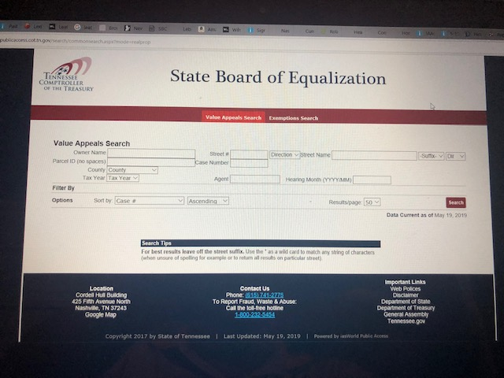

Slide 18
Refunds or Additional Taxes Owed
Accrues interest from the original delinquency date at the composite prime rate published by the Federal Reserve Board as of the delinquency date, minus two (2) points.
TCA §67-5-1512(b)
Refunds you pay interest
Additional taxes you charge interest

Slide 19
Federal Reserve Board Prime Interest Rates
The SBOE publishes the prime rates on their website
file:///C:/Users/rtlee/Documents/Word/SBOE%20-%20Interest%20Rates%202019.pdf
Use these rates minus 2 points

Slide 20
SBOE Interest Rates

Slide 21
Notice of Final Action
SBOE will notify Assessor and Trustee of final action of the SBOE via email.
Trustee should notify any city collector.
Starts the clock on refunds and collection of additional taxes.
Additional taxes – Delinquent 30 days after SBOE final action.
Refunds – Interest rate paid increased
by two (2) points 60 days after notice.
TCA §67-5-1512

Slide 23
Penalties and Interest
Disputed portion of the tax is not considered delinquent until 30 days after issuance of the final assessment certificate of the SBOE.
Does not accrue penalty and interest
Can not be turned over for delinquent suit

Slide 24
Questions?
TCAA 2022 Annual Meeting
(Knoxville, Tennessee, April 30, 2022)
Robert Lee
rtlee.law@comcast.net
(615) 415-9482

