Slide 1
TCAA SPRING CONFERENCE 2024
Presented by Laura Chastain
Ethics Counsel
Board of Professional Responsibility

Slide 2

SOME COUNTY ATTORNEY ISSUES
OPEN MEETINGS ACT
OUSTER
GOVERMENTAL TORT LIABILITY ACT
PUBLIC DUTY DOCTRINE
SPECIAL-DUTY EXCEPTION
This Photo by Unknown Author is licensed under CC BY-NC-ND

Slide 3

OPEN MEETINGS ACT

Slide 4
OPEN MEETINGS ACT
“GOVERNMENT LAWYERS IN TENNESSEE ARE ALSO SUBJECT TO THE OPEN MEETINGS ACT AS INTERPRETED BY THE TENNESSEE COURTS.”
RPC SCOPE COMMENT [19]

Slide 5

STATEMENT OF PURPOSE
“The general assembly hereby declares it to be the policy of this state that the formation of public policy and decisions is public business and shall not be conducted in secret.”

Slide 6
TENNESSEE OPEN MEETINGS ACT TCA 8-44-101
The law says that actions taken at a meeting in violation of the Open Meetings Act “shall be void and of no effect…” TCA 8-44-105. The Act also given the courts jurisdiction to “issue injunctions, impose penalties and otherwise enforce the purposes” of the Act if a citizen files a lawsuit.

Slide 7
“ADEQUATE PUBLIC NOTICE”
In order to meet the requirements of the Open Meetings Act, “Adequate Public Notice” must be given before all meeting to which the Act applies. TCA 8-44-103.

Slide 8
Tennessee Court of Appeals Three Prong Test for “Adequate Public Notice”:
1. Notice must be posted in a location where a member of the community could become aware of the notice,
2. The contents of the notice must reasonably describe the purpose of the meeting or the action to be taken, and
3. The notice must be posted at a time sufficiently in advance of the meeting to give citizens an opportunity to become aware of the meeting and to attend.
Englewood Citizens for Alternate B v. Town of Englewood, 199 WL 419710 (Tenn, Ct. App. 1999).

Slide 9
THE REQUIREMENTS OF THE OPEN MEETINGS LAW ARE IN ADDITION TO ANY OTHER NOTICE REQUIRED BY LAW
Example: Meetings of county legislative bodies, are also governed by the provisions of TCA 5-5-104 and TCA 5-5-105 which require regular meetings to be set by resolution of the county legislative body, and special called meetings require newspaper notice at least five days prior to the meeting that contains the agenda for the meeting.

Slide 10
GRAY V. DICKSON COUNTY, No. M2021-00546-COA-R3-CV, 2022 WL 1701961 (Tenn. Ct. App. May 27, 2022)
NO VIOLATION OF OPEN MEETINGS ACT.
“REQUIRES NOTICE OF THE MEETING ITSELF AND DOES NOT SPEAK TO NOTICE OF THE CONTENT OF THE MEETING” FOR REGULARY SCHEDULED MEETINGS. Fisher v. Rutherford Cty. Reg’l Plan. Comm’n, No. M2012-01397-COA-R3CV, 2013 WL 2382300, at *6 (Tenn. Ct. App. May 29, 2013)

Slide 11
IF THE OPEN MEETINGS ACT IS VIOLATED:
Any citizen of the state may bring an action against a public body in violation of the law. Any action taken during a meeting in violation of the Open Meetings Act is considered void.
The enforcement of the Open Meetings Act has been left to citizens and the press through lawsuits in local Chancery and Circuit courts.

Slide 12
KNOX COUNTY OPEN MEETINGS VIOLATION LED TO A JURY TRIAL
In 2007 several Knox County Commissioners deliberated privately before voting to fill eight vacancies on the Commission and 4 vacant countywide offices, including the Sheriff.
After a two week jury trial, the judge accepted the jury’s verdict and removed all 12 officials from office.

Slide 13
OCTOBER 8, 2020 TN JUDGE RULED CAMPAIGN FINANCE AGENCY’S EMAIL VOTE VIOLATED OPEN MEETINGS ACT.
Chancellor Ellen Hobbs Lyle issued a written order granting final judgment in favor of plaintiffs in Associated Press v. Tennessee Registry of Election Finance. The Registry “violated the spirit and requirements of the [Open Meetings Act] by deciding via an email vote whether to recommend settlement with Representative [Joe] Towns.”

Slide 14
CAN A VIOLATION OF OPEN MEETINGS LAW BE REMEDIED?
IF SO, HOW?

Slide 15
ANSWER
“Even if members of a public body engage in conduct that violates the Open Meetings Act, the action of the public body will not be deemed void if, in the interim, there was a ‘new and substantial reconsideration of the issues involved, in which the public is afforded ample opportunity to know the facts and to be heard with reference to the matters at issue.’ “ Neese v. Paris Special School Dist., 813 S.W. 2d 432, 436 (Tenn. Ct. App. 1990)
Cited by the TN Supreme Court in Johnston v. Metro Gov’t of Nashville and Davidson Cty.,320 S.W. 3d 299, 313 (Tenn. Ct. App. 2009).

Slide 16
ADMINISTRATIVE LAW AND PROCEDURE TCA 8-44-101 et seq.
EVEN IF THERE HAS BEEN A VIOLATION OF THE OPEN MEETINGS ACT, THE PUBLIC BODY’S ACTION WILL NOT BE VOIDED IF, AFTER THE VIOLATIVE CONDUCT OCCURRED, THERE WAS A NEW AND SUBSTANTIAL RECONSIDERATION OF THE ISSUES INVOLVED AT WHICH THE PUBLIC COULD BE PRESENT.

Slide 17
Newsom v. Tennessee Republican Party, 647 S.W.3d 382 (Tenn. 2022)
“ONLY STATE PRIMARY BOARDS, NOT THE STATE EXECUTIVE COMMITTEES, ARE REQUIRED TO COMPLY WITH THE TENNESSEE OPEN MEETINGS ACT.”
NO VIOLATION OF THE OPEN MEETINGS ACT

Slide 18

I AM A COUNTY ATTORNEY AND THE COUNTY COMMISSIONERS WANT TO MEET WITH ME TO DETERMINE WHAT ACTION TO TAKE WITH REGARD TO A POTENTIAL LAWSUIT. DOES THIS VIOLATE THE OPEN MEETINGS ACT?

Slide 19

SMITH COUNTY EDUCATION ASSOCIATION V. ANDERSON, 676 S.W. 2d 328, 334 (TENN. 1984) GIVES GUIDANCE ON THIS ISSUE.

Slide 20
TENNESSEE’S OPEN MEETING ACT PROVIDES THAT THE FORMATION OF PUBLIC POLICY AND DECISIONS IS PUBLIC BUSINESS AND SHALL NOT BE CONDUCTED IN SECRET. TENNESSEE CODE ANNOTATED SECTION 8-44-101(a).
THEREFORE, IF THE COMMISSION MEMBERS WANT TO DISCUSS IN A CLOSED MEETING WHAT ACTION TO TAKE, SUCH DISCUSSION WOULD VIOLATE THE OPEN MEETINGS ACT.
THE OPEN MEETINGS ACT MAY NOT, HOWEVER, RESTRICT THE COMMISSION FROM CONFERRING IN PRIVATE WITH ITS LEGAL COUNSEL CONCERNING PENDING OR THREATENED LITIGATION. ARTICLE II, SECTIONS 1 AND 2 OF THE TENNESSEE CONSTITUTION.
DISCUSSION WITH COUNSEL REGARDING PENDING OR THREATENED LITIGATION IS A VERY NARROW EXCEPTION TO OPEN MEETINGS ACT.

Slide 21
“THE EXCEPTION IS LIMITED TO MEETINGS IN WHICH DISCUSSION OF PRESENT AND PENDING LITIGATION TAKES PLACE. CLIENTS MAY PROVIDE COUNSEL WITH FACTS AND INFORMATION REGARDING THE LAWSUIT AND COUNSEL MAY ADVISE THEM ABOUT THE LEGAL RAMIFICATIONS OF THOSE FACTS AND THE INFORMATION GIVEN TO HIM. HOWEVER, ONCE ANY DISCUSSION, WHATSOVER, BEGINS AMONG THE MEMBERS OF THE PUBLIC BODY REGARDING WHAT ACTION TO TAKE BASED UPON ADVICE FROM COUNSEL, WHETHER IT BE SETTLEMENT OR OTHERWISE, SUCH DISCUSSION SHALL BE OPEN TO THE PUBLIC AND FAILURE TO DO SO SHALL CONSTITUTE A CLEAR VIOLATION OF THE OPEN MEETINGS ACT.”
Smith County Education Association v. Anderson, 676 SW 2d. 328, at 334 (Tenn. 1984)

Slide 22

OUSTER

Slide 23
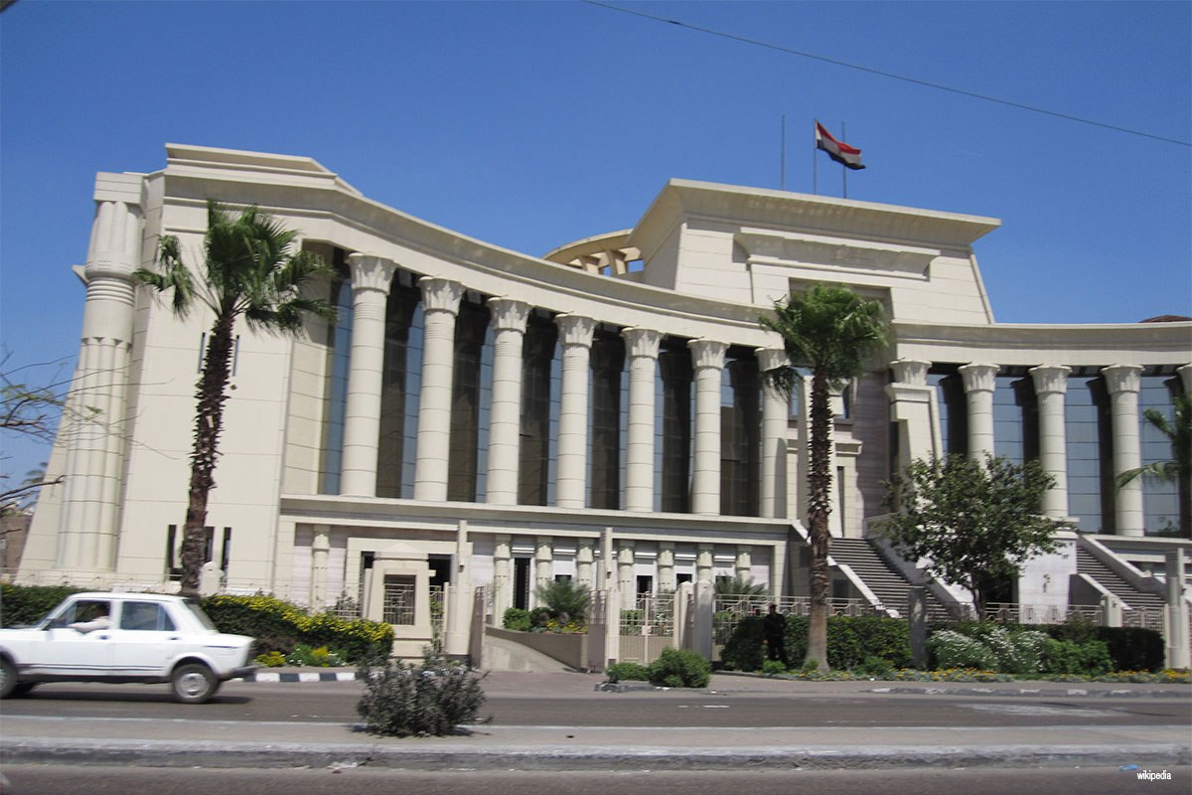
AS COUNTY ATTORNEY CAN I BE COMPELLED TO ASSIST CITIZENS IN OUSTING A LOCALLY ELECTED OFFICIAL?

Slide 24
ANSWER: YES
“CITY AND COUNTY ATTORNEYS ARE NOT ONLY EMPOWERED TO SEEK THE OUSTER OF THEIR OWN CLIENTS, BUT IN CERTAIN CIRCUMSTANCES ARE COMPELLED TO DO SO.
FOR INSTANCE, IN THE EVENT A GROUP OF 10 OR MORE CITIZENS SEEKS TO OUST A LOCALLY ELECTED OFFICIAL, THE CITY OR COUNTY ATTORNEY REPRESENTING THAT OFFICIAL CAN BE COMPELLED TO ASSIST THE CITIZENS IN REMOVING HIM OR HER. THE STATUTE SPECIFICALLY REQUIRES CITY AND COUNTY ATTORNEYS TO AID AND ASSIST SUCH CITIZENS IN THE PROSECUTION OF OUSTER PROCEEDINGS AGAINST CITY AND COUNTY OFFICIALS.” TCA 8-47-111.
“You’re Out of There!” by Joseph Jarrett
Tennessee Bar Association 2/1/16.

Slide 25
RUTHERFORD COUNTY DA, COUNTY ATTORNEY SCOLDED IN SHERIFF ARNOLD CASE
CHANCELLOR YOUNG’S RULING THAT SUSPENDED JAILED SHERIFF ROBERT ARNOLD ALSO SCOLDED DISTRICT ATTORNEY GENERAL AND COUNTY ATTORNEY FOR NOT PARTICIPATING IN THE OUSTER SUIT.
“WHILE THE DISTRICT ATTORNEY AND THE COUNTY ATTORNEY MAY HAVE HAD GOOD REASONS FOR NOT ASSISTING THE PLAINTIFFS, BOTH OFFICES REMAIN UNDER A STATUTORY RESPONSIBILITY TO DO SO.” “FUTHER IF THE DISTRICT ATTORNEY AND HIS OFFICE ARE DISQUALIFIED FROM ASSISTING THE PLAINTIFFS, TENNESSEE LAW PROVIDES A MECHANISM FOR THE DISTRICT ATTORNEY TO MEET HIS OFFICE’S OBLIGATION UNDER (THE STATE CODE) BY OBTAINING THE APPOINMENT OF A DISTRICT ATTORNEY GENERAL PRO TEM.” Chancellor William Young

Slide 26

IN THE EVENT THAT A GROUP OF 10 OR MORE CITIZENS SEEK TO OUST A LOCALLY ELECTED OFFICIAL, THE CITY OR COUNTY ATTORNEY REPRESENTING THAT OFFICIAL CAN BE COMPELLED TO ASSIST THE CITIZENS IN REMOVING THE OFFICIAL. TCA 8-47-111 SPECIFICALLY REQUIRES CITY AND COUNTY ATTORNEYS TO AID AND ASSIST SUCH CITIZENS IN THE PROSECUTION OF OUSTER PROCEEDINGS AGAINST CITY AND COUNTY OFFICIALS.

Slide 27

WHAT IF THE COUNTY EXECUTIVE ASKS ME TO BRING AN OUSTER SUIT AGAINST A COMMISSIONER THAT IS A GOOD FRIEND OF MINE AND I THINK THAT I HAVE A CONFLICT WHAT SHOULD I DO ?

Slide 28
QUESTIONS CONCERNING WHETHER THE ACTIVITIES BY THE COUNTY ATTORNEY ARE PERMITTED BY THE ETHICAL CANONS GOVERNING THE PRACTICE OF LAW SHOULD BE ADDRESSED TO THE BOARD OF PROFESSIONAL RESPONSIBILITY.
TENNESSEE ATTORNEY GENERAL’ S OPINION NO. 00-129 , AUGUST 14, 2000.

Slide 29
RULE 1.7 APPLIES HERE.
“ A LAWYER SHALL NOT REPRESENT A CLIENT IF THE REPRESENTATION INVOLVES A CONCURRENT CONFLICT OF INTEREST EXISTS.”
“A CONCURRENT CONFLICT OF INTEREST EXISTS IF THERE IS A SIGNIFICANT RISK THAT THE REPRESENTATION OF ONE OR MORE CLIENTS WILL BE MATERAILLY LIMITED BY THE LAWYER’S RESPONSIBLITIES TO ANOTHER CLIENT, A FORMER CLIENT, OR A THIRD PERSON OR BY A PERSONAL INTEREST OF THE LAWYER.”
TENNESSEE RULES OF PROFESSIONAL CONDUCT 1.7(a)(2).

Slide 30

I AM A COUNTY ATTORNEY. DO I HAVE A CONFLICT OF INTEREST IN INVESTIGATING A COMMISSIONER FOR A COUNTY WHICH EMPLOYEES ME ?

Slide 31

A COMPARABLE QUESTION WAS THE SUBJECT OF AN ATTORNEY GENERAL’S OPINION AS TO WHETHER CITY ATTORNEY HAS A CONFLICT OF INTEREST IN INVESTIGATION AN OUSTER COMPLAINT AGAINST A COMMISSIONER FOR A CITY WHICH EMPLOYS THE ATTORNEY.

Slide 32

“No Statute prohibits a city attorney from investigating an ouster complaint against a commissioner for a city which employs the attorney. Questions concerning whether such activities by a City Attorney are permitted by the ethical canons governing the practice of law should be addressed to the Board of Professional Responsibility.” Attorney General Opinion No. 00-129, August 14, 2000.

Slide 33

I AM A COUNTY ATTORNEY AND THE COMMISSIONERS HAVE VIOLATED THE OPEN MEETINGS ACT. IS THERE ANY WAY TO FIX THIS PROBLEM?

Slide 34
JOHNSTON V. METRO GOV’T OF NASHVILLE AND DAVIDSON CTY, 320 S.W.3d 313 (Tenn. Ct. App. 2009)
CURING THE VIOLATION IS ALLOWED UNDER THIS CASE.
RESIDENTS OF A NEIGHBORHOOD WHO OPPOSED ZONING CHANGE FILED SUIT SEEKING WRIT OF CERTIORARI TO REVIEW THE ADOPTION OF ORDINANCE, CONTENDING THAT ITS PASSAGE VIOLATED OPEN MEETINGS LAW, SEPARATION OF POWERS DOCTRINE, AND DUE PROCESS. THE CHANCERY COURT DENIED WRIT AND RESIDENTS APPEALED.

Slide 35
THE COURT OF APPEALS HELD:
1. EMAIL COMMUNICATION AMONG THE METROPOLITAN COUNCIL MEMBERS VIOLATED OPEN MEETINGS ACT;
2. COUNCIL MEMBERS’ MEETING IN COUNCIL’S BACK CONFERENCE ROOM DID NOT VIOLATE THE OPEN MEETINGS ACT;
3. NEW AND SUBSTANTIAL RECONSIDERATION OF THE ISSUES BEFORE PASSAGE OF ORDINANCE CURED ANY VIOLATION OF OPEN MEETINGS ACT;
4. ENABLING STATUTE AUTHORIZING ZONING COMMISSION TO ADOPT DESIGN GUIDELINES FOR MUNICIPAL DISTRICT DID NOT VIOLATE THE SEPARATION OF POWERS DOCTRINE; AND
5. TRIAL COURT’S DECSION TO RESTRICT DISCOVERY WAS NOT ABUSE OF DISCRETION.

Slide 36
ADMINISTRATIVE LAW AND PROCEDURE TCA 8-44-101 et seq.
EVEN IF THERE HAS BEEN A VIOLATION OF THE OPEN MEETINGS ACT, THE PUBLIC BODY’S ACTION WILL NOT BE VOIDED IF, AFTER THE VIOLATIVE CONDUCT OCCURRED, THERE WAS A NEW AND SUBSTANTIAL RECONSIDERATION OF THE ISSUES INVOLVED AT WHICH THE PUBLIC COULD BE PRESENT.

Slide 37
GOVERMENTAL TORT LIABILITY ACT
PUBLIC DUTY DOCTRINE
SPECIAL-DUTY EXCEPTION

Slide 38
THE DOCTRINE OF SOVEREIGN IMMUNITY
Part of common law in TN for over one hundred years.
The State and its political subdivisions were generally immune from suit.
However, “sovereign immunity does not bar suit when the government has ‘specifically consented to be sued.’”
TN Constitution authorizes TN Legislature to allow certain suits against governmental entities.
Lawson v. Hawkins County, 661 SW3d 54, at 59 (Tenn. 2023), citing (Tenn. Const. art.I, section 17)

Slide 39

1973 TENNESSEE LEGISLATURE PASSED GOVERNMENTAL TORT LIABILITY ACT

Slide 40
Larry King, et al v. Town of Selmer, Tennessee, No. W2023-00390-COA-R9-CV (filed January 8, 2024 at Jackson), 2024 WL 81516, (Tenn. Ct. App.)
1. Whether the Town is immune under the Public Duty Doctrine from Larry King and Brittany Johnson’s claims against the Town?
2. Whether the Town is immune under the Tennessee Governmental Tort Liability Act from Larry King and Brittany Johnson’s joint venture claim against the Town?

Slide 41
PUBLIC DUTY DOCTRINE
IN ADDITION TO THE GTLA, THE PUBLIC DUTY DOCTRINE PROVIDES AN AFFIRMATIVE DEFENSE THAT MAY “SHIELD A PUBLIC EMPLOYEE FROM SUITS FOR INJURIES THAT ARE CAUSED BY THE PUBLIC EMPLOYEE’S BREACH OF A DUTY TO THE PUBLIC AT LARGE.”
Ezell v. Cockrell, 902 S.W.2d 394, 397 (Tenn. 1995)

Slide 42
INTERPLAY OF GTLA AND THE PUBLIC DUTY DOCTRINE
Courts first look to the GTLA. If immunity is found under the GTLA, a court need not inquire as to whether the public duty doctrine also provides immunity. If, however, the GTLA does not provide immunity, courts may look to the general rule of immunity under the public duty doctrine. If immunity is then found under the public duty doctrine, the next inquiry is whether the special duty exception removes the immunity afforded under the public duty doctrine.

Slide 43
SPECIAL DUTY EXCEPTION
The special duty exception removes the immunity when:
(1) a public official affirmatively undertakes to protect the plaintiff and the plaintiff relies upon the undertaking;
(2) a statute specifically provides for a cause of action against an official or municipality for injuries resulting to a particular class of individuals, of which the plaintiff is a member, from failure to enforce certain laws; or
(3) a plaintiff alleges a cause of action involving intent, malice or reckless conduct.

Slide 44
COURT OF APPEALS FINDINGS
THE PUBLIC-DUTY DOCTRINE SHIELDS THE TOWN FROM LIABILITY.
THE SPECIAL-DUTY EXCEPTION DOES NOT APPLY.
THE “JOINT VENTURE” CLAIMS ARE SIMPLY ADDITIONAL NEGLIGENCE CLAIMS SEEKING TO HOLD THE TOWN LIABLE FOR THE ALLEGED NEGLIGENCE OF OTHER DEFENDANTS.
BECAUSE THE TN LEGISLATURE HAS NOT WAIVED GOVERNMENTAL IMMUNITY UNDER SUCH CIRCUMSTANCES, TOWN’S IMMUNITY WAS NEVER REMOVED AS TO THE “JOINT VENTURE” CLAIMS.

Slide 45

ETHICS

Slide 46
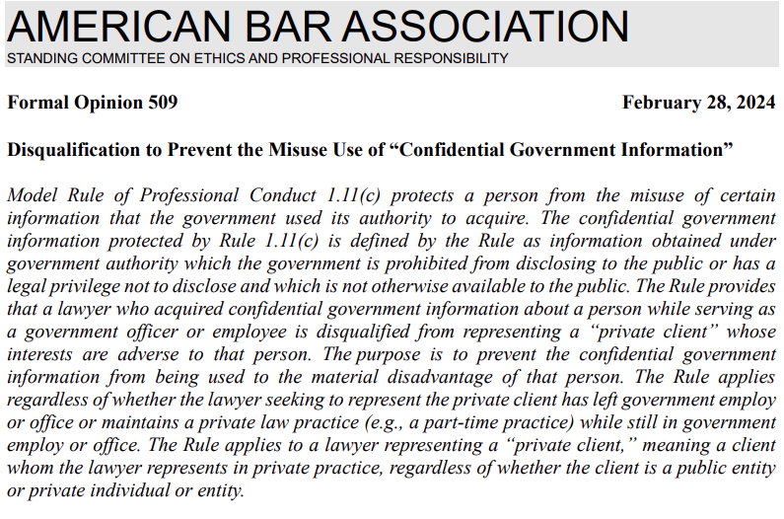
ABA FORMAL OPINION 509

Slide 47
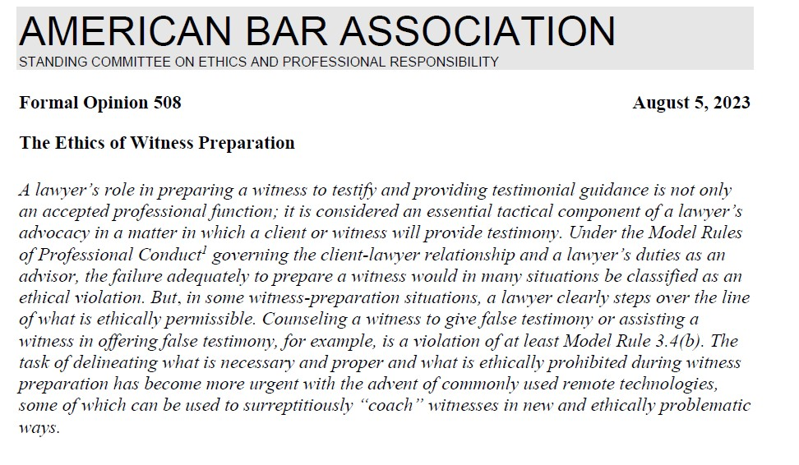
ABA FORMAL OPINION 508

Slide 48
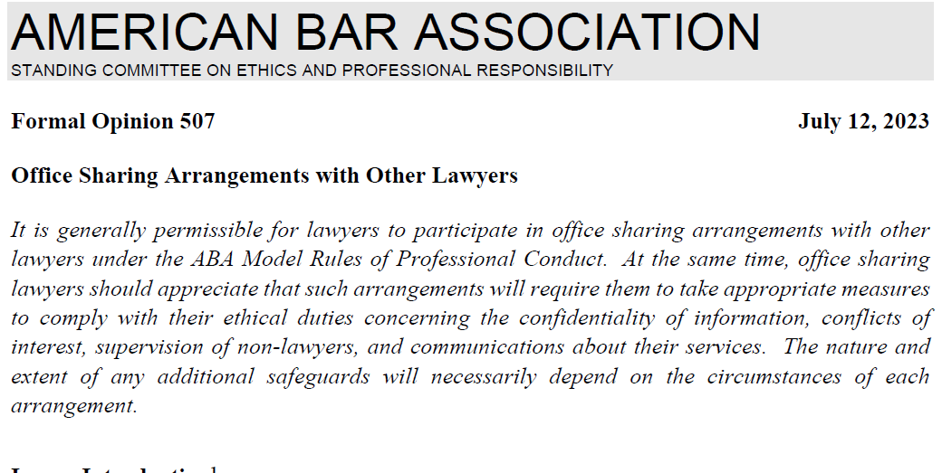
ABA FORMAL OPINION 507

Slide 49
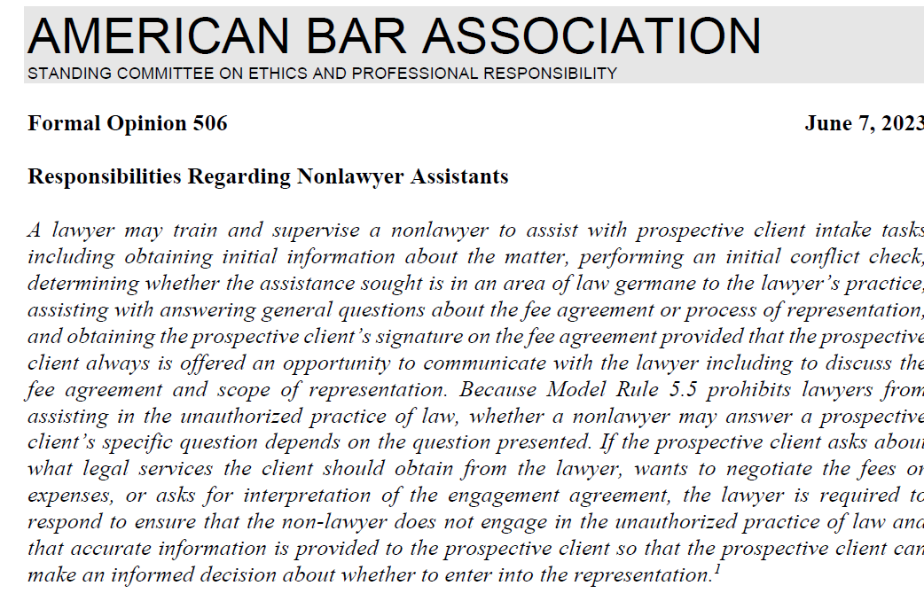
ABA FORMAL OPINION 506

Slide 50
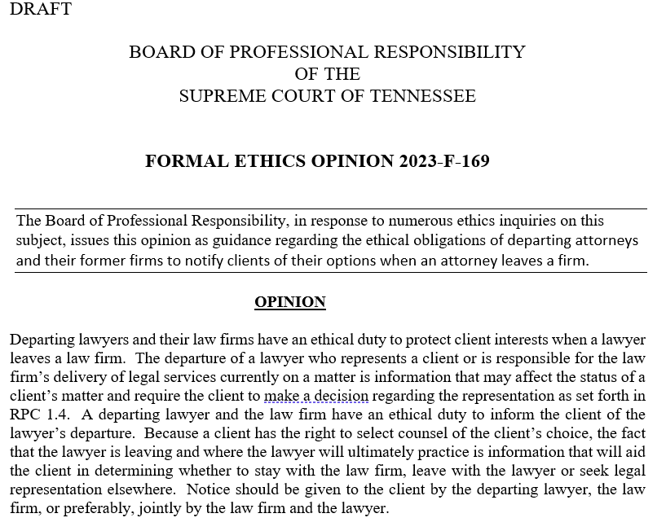

Slide 51


CHAT GPT LAWYER
JUDGE FINDS OUT WHY
BRIEF CITED NONEXISTENT CASES—
ChatGPT DID THE RESEARCH

Slide 52

FLORIDA’S ETHICS OPINION ON GENERATIVE AI
Ethics Opinion 24-1

Slide 53

THE COURTS AND AI

Slide 54

NEW SECTION TO TRUST ACCOUNT RULE

Slide 55
NEW SECTION (f) ADDED TO EXISTING TRUST ACCOUNT RULE 1.15
RPC 1.15(f) A lawyer who learns of unidentified funds in an IOLTA account must make periodic efforts to identify and return the funds to the rightful owner. If after 12 months of the discovery of the unidentified funds the lawyer determines that ascertaining the ownership or securing the return of the funds will not succeed, the lawyer must remit the funds to the Tennessee Lawyers’ Fund for Client Protection (TLFCP). No charge of ethical impropriety or other breach of professional conduct shall attend to a lawyer’s exercise of reasonable judgment under this paragraph (f).

Slide 56
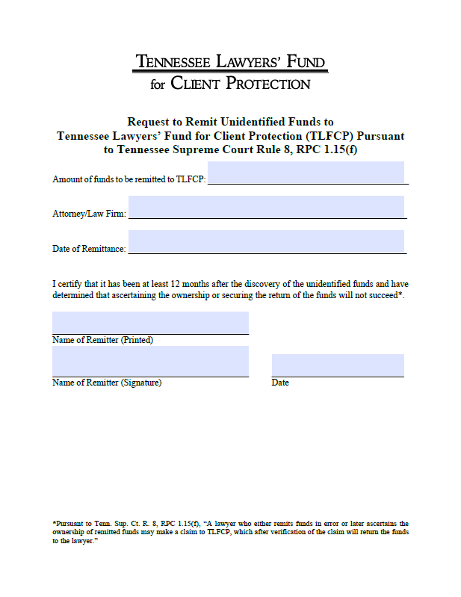
NEW FORM FOR LAWYERS’ FUND FOR CLIENT PROTECTION

Slide 57
Tenn. Sup. Ct. R. 25 § 1 Tennessee Lawyers’ Fund for Client Protection
1.01: The Tennessee Lawyers’ Fund for Client Protection reimburses claimants for losses caused by any dishonest conduct committed by lawyers practicing in this state.
1.02: The purpose of the Tennessee Lawyers’ Fund for Client Protection is to promote public confidence in the administration of justice and the integrity of the legal profession as a whole by reimbursing losses caused by the rare instances of dishonest conduct of lawyers practicing in this state.
1.03: “Dishonest conduct” means the misappropriation or willful misapplication of a person’s money, securities or other property.

Slide 59

1,029 COMPLAINTS FILED LAST YEAR
This Photo by Unknown Author is licensed under CC BY-SA

Slide 60
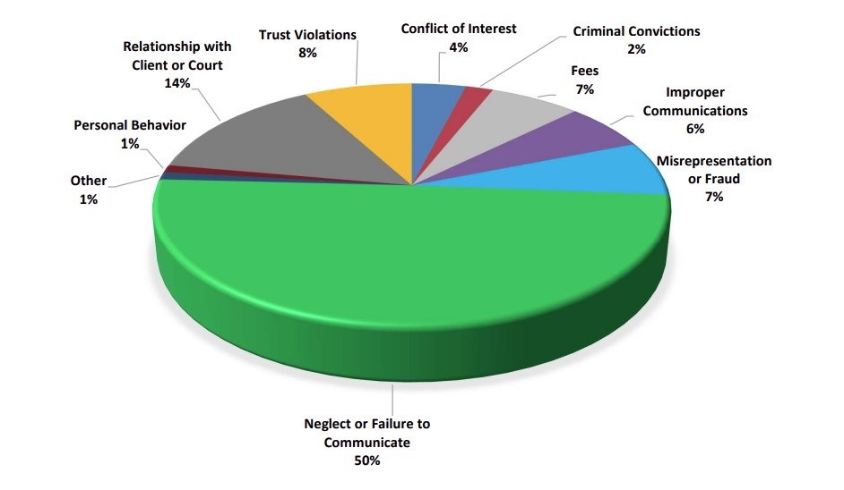

Slide 61

RESULTS OF INVESTIGATIONS
Administrative Dismissals: 286
Investigative Dismissals: 445
Diversions: 60
Private Informal Admonitions: 21
Private Reprimands: 14
Informal Public Censures: 22
Transfer to Disability Inactive: 9
Transferred to Litigation 92
Placed on Retired Status: 26
Other:18
Catholic Lawyers Guild Catholic Lawyers Guild Catholic Lawyers Guild
This Photo by Unknown Author is licensed under CC BY-NC

Slide 62
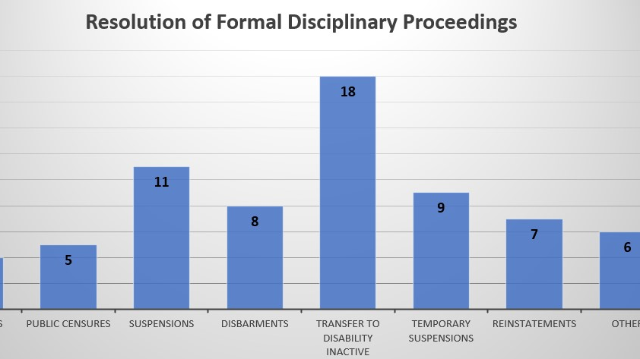

Slide 63
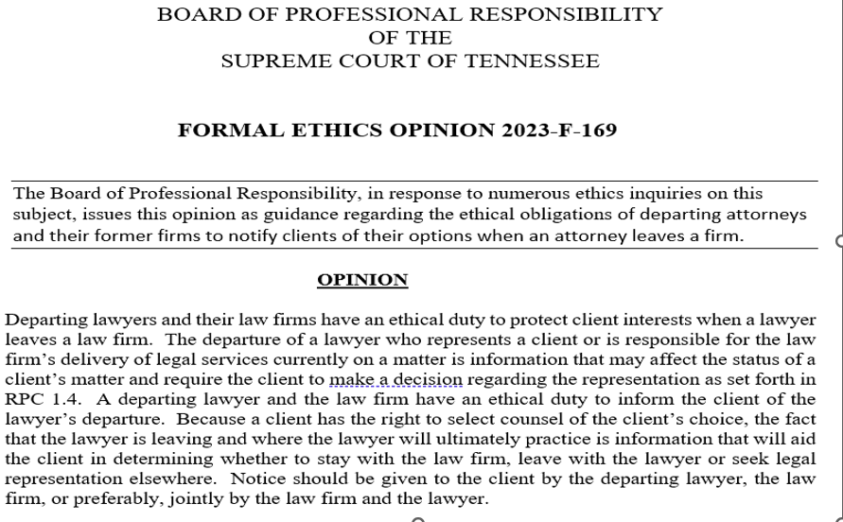

Slide 64

SUCCESSION PLANNING

Slide 65


Tennessee Lawyer Demographics
Years Licensed in TN
24,280
active TN lawyers
35% less than 10 years
24% between 10-20 years
18% between 20-30 years
23% over 30 years
Age
28% are 60+
46% are 40-59
26% are under 40

Slide 66

Don’t - wait for imminent retirement to do succession planning

Slide 67


SHOCK IMPACT OF A SUDDEN CESSATION
Atlanta attorney Page Pate dies in swimming accident off Georgia coast
Skadden Rainmaker Scott Simpson Dies Suddenly, Aged 65
Alta Spells, Maria Cartaya, Martin Savidge and Theresa Waldrop - September 13, 2022
Paul Hodkinson - May 30, 2022

Slide 69

Tenn. Sup. Ct. R. 9, Section 29.2
Appointment of a Receiver Attorney

Slide 70

Tenn. Sup. Ct. R. 9, Section 29.7
Limitation of Liability
Any person serving as a receiver attorney under this Rule shall be immune from suit for any conduct undertaken in good faith in the course of the official duties of the receiver attorney.

Slide 71

Tenn. Sup. Ct. R. 9, Section 29.9
ADVANCED DESIGNATION OF A RECEIVER OR SUCCESSOR ATTORNEY

Slide 72
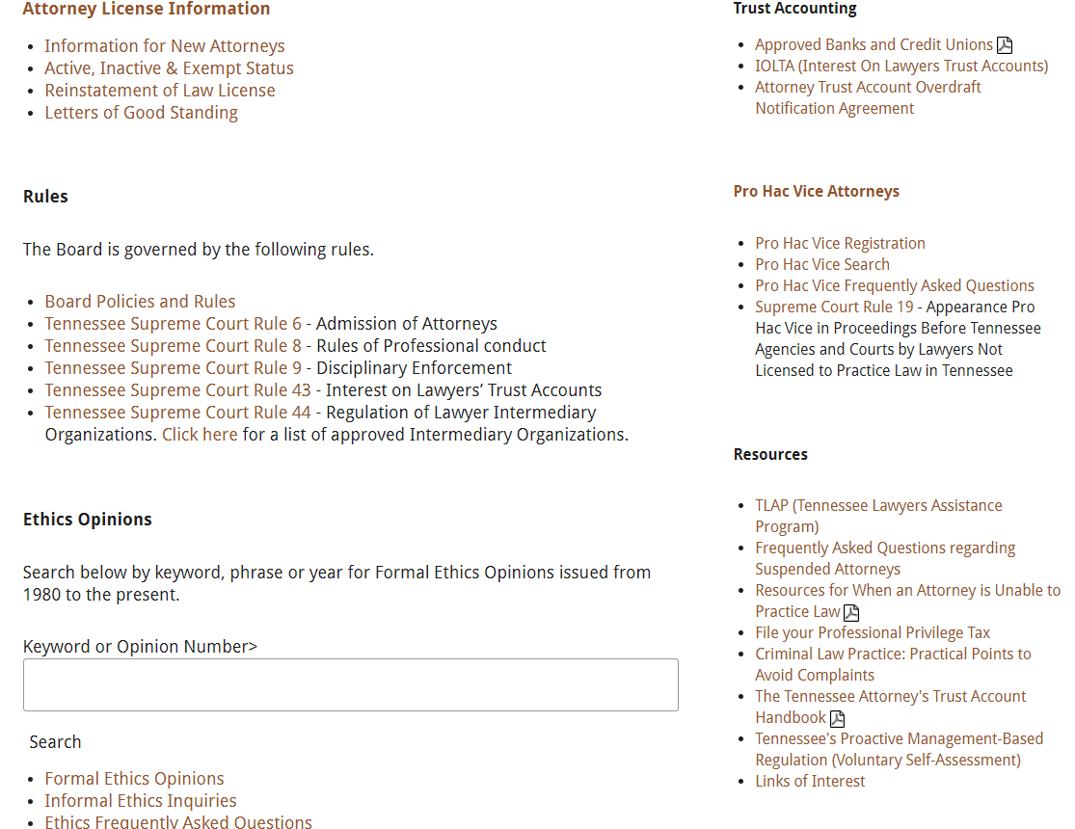


Slide 73

QUESTIONS ?
This Photo by Unknown Author is licensed under CC BY-NC-ND

Slide 74
CONTACT INFORMATION
ETHICS COUNSEL
Laura Chastain (615) 361-7500 ext. 212
lchastain@tbpr.org
Consumer Assistance Program (615) 361-7500
Tennessee Lawyers Assistance Program (615) 741-3238
Tennessee Board of Law Examiners (615) 741-3234
Tennessee Commission on Continuing Legal Education (615) 741-3096
Tennessee Board of Judicial Conduct (629-224-7482)
Tennessee Attorney General’s Office (615-741-3491)

