Slide 1

TCAA SPRING CONFERENCE 2025
Presented by Laura Chastain
Ethics Counsel
Board of Professional Responsibility

Slide 2

CONFLICTS, CONFIDENTIALITY CONFUSION

Slide 3

CONFLICTS

Slide 4
COUNTY ATTORNEYS HAVE MANY ETHICAL CHALLENGES
THE QUESTIONS THAT COUNTY ATTORNEYS ASK ME ABOUT THE MOST, INVOLVE CONFLICTS OF INTEREST.
LAST YEAR THERE WERE 628 CONFLICT OF INTEREST QUESTIONS POSED FOR ADVISORY OPINIONS.

Slide 5

HOW ARE GOVERNMENT LAWYERS DIFFERENT ?

Slide 6
GOALS, AUTHORITY, APPLICABLE LAW
PRIVATE ENTITIES HAVE WELL DEFINED OBJECTIVES (GOALS)
GOVERNMENT’S GOAL IS BROAD AND VAGUE: ACT IN THE PUBLIC INTEREST.
PRIVATE ENTITIES HAVE RELATIVELY CLEAR LINES OF AUTHORITY.
GOVERNMENT MORE DIFFUSE AND GOVERNMENT LAWYERS MAY HAVE MORE DISCRETION IN SOME SITUATIONS THAN LAWYERS REPRESENTING PRIVATE ORGANIZATIONS.

Slide 7
FOR EXAMPLE:
TN RULES OF PROFESSIONAL CONDUCT, SCOPE(19)
“….THE REPSONSIBILITIES OF GOVERNMENT LAWYERS MAY DIFFER FROM THOSE OF LAWYERS IN PRIVATE CLIENT-LAWYER RELATIONSHIPS. CERTAIN GOVERNMENT LAWYERS MAY BE AUTHORIZED TO REPRESENT SEVERAL GOVERNMENT AGENCIES, OFFICERS, OR EMPLOYEES IN LEGAL CONTROVERSIES IN CIRCUMSTANCES WHERE A PRIVATE LAWYER COULD NOT REPRESENT MULTIPLE CLIENTS.”
“….THEY MAY HAVE AUTHORITY TO REPRESENT THE ‘PUBLIC INTEREST’ IN CIRCUMSTANCES WHERE A PRIVATE LAWYER WOULD NOT BE AUTHORIZED TO DO SO.”

Slide 8
APPLICABLE CASE
IN THE CASE OF WOOD, ET AL. V. METROPOLITAN BOARD OF HEALTH ET AL., 2009 Tenn. App. LEXIS 732 (November 28, 2007), WHICH WAS AN APPEAL CHALLENGING THE ISSUANCE OF SEVERAL PERMITS BY THE AIR POLLUTION DIVISION OF THE METROPOLITAN DEPARTMENT OF HEALTH. PART OF THAT CHALLENGE WAS THE REPRESENTATION OF BOTH THE DEPARTMENT OF HEALTH AND THE BOARD OF HEALTH BY METROPOLITAN DEPARTMENT OF LAW ATTORNEYS.
THE APPELLANT MAINTAINED THAT THE SAME METROPOLITAN ATTORNEY REPRESENTED THE INTERESTS OF THE DIRECTOR OF THE AIR POLLUTION DIVISION AND THE BOARD OF HEALTH, WHICH WAS NOT SUPPORTED BY THE RECORD WHICH SHOWED THAT TWO DEPARTMENT OF LAW ATTORNEYS REPRESENTED THE TWO PARTIES.
THE COURT HELD THAT THE METROPOLITAN CHARTER REQUIRES THAT THE DEPARTMENT OF LAW PROVIDE COUNSEL TO THE DEPARTMENT AND THE BOARD. ONE ATTORNEY ADVISED THE BOARD AND ONE ADVISED METRO.

Slide 9

CAN A MUNICIPAL GOVERNMENT SUE ONE OF IT’S OWN AGENCIES?

Slide 10
ANSWER: YES
THE TENNESSEE SUPREME COURT HAS RULED THAT THE METROPOLITAN GOVERNMENT OF NASHVILLE HAD STANDING TO SUE IT’S OWN AGENCY, THE BOARD OF ZONING APPEALS OF NASHVILLE.
THE METROPLITAN GOVERNMENT OF NASHVILLE AND DAVIDSON COUNTY, TENNESSEE V. THE BOARD OF ZONING APPEALS OF NASHVILLE AND DAVIDSON COUNTY, TENNESSEE ET AL., 477 S.W.3d 750 (TN. 2015).
THE COURT HELD THAT IT IS POSSIBLE FOR METRO TO BE “AGGRIEVED” BY A DECISION OF ITS BOARD OF ZONING APPEALS.
METRO ALLEGED THAT THE BOARD OF ZONING APPEALS DECISION WILL INTERFERE WITH ITS DUTY TO ENFORCE CERTAIN OF ITS ORDINANCES. THE COURT FOUND METRO HAD STANDING TO SUE ITS BOARD BECAUSE IT WOULD BE UNABLE TO ENFORCE CERTAIN OF ITS ORDINANCES. The case was remanded to the chancery court for further proceedings.

Slide 11
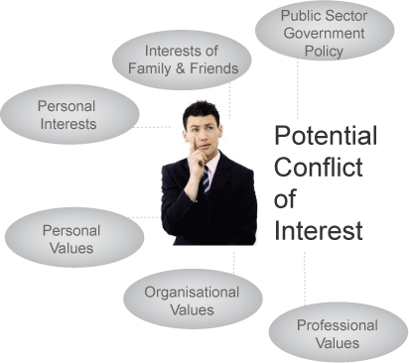
CONFLICTS OF INTEREST—MAJOR CONCERN FOR COUNTY ATTORNEYS

Slide 12

RPC 1.7(a) CONFLICTS OF INTEREST: CURRENT CLIENTS
EXCEPT AS PROVIDED IN PARAGRAPH (b), A LAWYER SHALL NOT REPRESENT A CLIENT IF THE REPRESENTATION INVOLVES A CONCURRENT CONFLICT OF INTEREST. A CONCURRENT CONFLICT OF INTEREST EXISTS IF:
1. THE REPRESENTATION OF ONE CLIENT WILL BE DIRECTLY ADVERSE TO ANOTHER CLIENT.
2. THERE IS A SIGNIFICANT RISK THAT THE REPRESENTATION OF ONE OR MORE CLIENTS WILL BE MATERIALLY LIMITED BY THE LAWYER’S RESPONSIBILITIES TO ANOTHER CLIENT, A FORMER CLIENT, OR A THIRD PERSON OR BY A PERSONAL INTEREST OF THE LAWYER.

Slide 13

MANY CONFLICTS QUESTIONS CAN BE RESOLVED BY KNOWING THE IDENTITY OF YOUR CLIENT.
This Photo by Unknown Author is licensed under CC BY-SA

Slide 14
WHO IS THE COUNTY ATTORNEY’S CLIENT ?
THIS IS AN IMPORTANT QUESTION FOR A COUNTY ATTORNEY TO ANSWER BECAUSE THE ATTORNEY HAS A DUTY TO SAFEGUARD HIS OR HER CLIENT’S CONFIDENCES.
ALSO, THE COUNTY ATTORNEY HAS THE DUTY TO AVOID CONFLICTS OF INTEREST.

Slide 15



Slide 16
THE UNDERLYING RULE OF PROFESSIONAL CONDUCT IS 1.13
“A LAWYER EMPLOYED OR RETAINED BY AN ORGANIZATION REPRESENTS THE ORGANIZATION ACTING THROUGH ITS DULY AUTHORIZED CONSTITUENTS.”

Slide 17
WHO ARE THE CONSTITUENTS ?
COUNTY OFFICIALS
COUNTY EMPLOYEES
COUNTY COMMISSIONERS
AGENTS OF THE COUNTY

Slide 18
ENABLING AUTHORITY
MOST GOVERNMENT LAWYER’ S OBLIGATIONS AND DUTIES ARE SET FORTH IN THEIR ENABLING AUTHORITY BY STATUTE OR CHARTER.

Slide 19
LEGISLATURE HAS NOT CREATED THE OFFICE OF COUNTY ATTORNEY AS A GENERAL LAW APPLICABLE TO ALL COUNTIES
IN COUNTIES HAVING A POPULATION OF LESS THAN 400,000 THAT ADOPT THE COUNTY MANAGER FORM OF GOVERNMENT ARE REQUIRED TO HAVE A COUNTY, ATTORNEY, BUT THERE IS NO SUCH REQUIREMENT OF OTHER COUNTIES.
THE DUTIES OF COUNTY ATTORNEYS DESCRIBED IN THE STATUTE APPLICABLE TO COUNTIES WHO ADOPT THE MANAGER FORM OF GOVERNMENT MIGHT OR MIGHT NOT INCLUDE REPRESENTING THE SHERIFF AND HIS DEPUTIES. T.C.A. 5-15-305

Slide 20

FOR MOST COUNTY ATTORNEYS, THE SCOPE OF REPRESENTATION IS SET OUT IN THE COUNTY CHARTER.

Slide 21
THE UNDERLYING RULE OF PROFESSIONAL CONDUCT IS 1.13
“A LAWYER EMPLOYED OR RETAINED BY AN ORGANIZATION REPRESENTS THE ORGANIZATION ACTING THROUGH ITS DULY AUTHORIZED CONSTITUENTS.”

Slide 22
NOT ALL TENNESSEE COUNTIES HAVE A COUNTY ATTORNEY.
T.C.A. 5-6-112 SET OUT THE POWERS AND DUTIES OF COUNTY EXECUTIVES AND PROVIDES: “IF THERE BE NO COUNTY ATTORNEY”, THE COUNTY EXECUTIVE MAY EMPLOY AN ATTORNEY TO ADVISE HIM AND THE LEGISLATIVE BODY OF THE COUNTY. ADDITIONAL DUTIES ARE LISTED WHICH APPARENTLY WOULD NOT INCLUDE REPRESENTING THE SHERIFF OR HIS DEPUTIES.

Slide 23

THE FOLLOWING HYPOTHETICALS EXPLORE SOME OF THE CONFLICTS OR POTENTIAL CONFLICTS COUNTY ATTORNEYS FACE.

Slide 24
HYPOTHETICAL 1
ATTORNEY A IS PART TIME COUNTY ATTORNEY. HIS OFFICE HANDLES CRIMINAL DEFENSE WORK. DOES HIS POSITION AS A PUBLIC OFFICIAL CONFLICT HIS LAW FIRM OUT OF THE DEFENSE OF CRIMINAL CASES IN HIS COUNTY?

Slide 25

THE ANSWER: IT DEPENDS….

Slide 26
EACH CASE MUST BE EXAMINED ON A CASE BY CASE BASIS
STATE OF TENNESSEE VS. JESSE JONES, IN RE: LARRY S. BANKS, ATTORNEY, 726 S.W.2d 515 (TENN. 1987).
This case set aside Formal Ethics Opinion 83-F-41 which unequivocally declared “county attorneys cannot represent criminal defendants prosecuted by county officers.” It also held partners and associates of the county attorney were disqualified.
The Supreme Court held that county attorneys and their partners are not per se disqualified from representing a criminal defendant, even though defendant is being prosecuted by county officers.

Slide 27

THE TENNESSEE SUPREME COURT FOUND THAT OPINION 83-F-41 WAS OVERBROAD
“CONFLICTS OF INTEREST, BOTH ACTUAL AND PERCEIVED, CANNOT BE DEALT WITH BY SUCH SWEEPING BLANKET PRONOUNCEMENTS. THERE MAY BE COUNTIES IN THIS STATE, WHERE, UPON EXAMINATION BY THE TRIAL JUDGE OF THE LAWYER-CLIENT RELATIONSHIP BETWEEN THE COUNTY ATTORNEY AND THE SHERIFF OR UPON EXAMINATION OF THE PERCEPTION OF THE COMMUNITY OF THAT RELATIONSHIP, DISQUALIFICATION OF THE COUNTY ATTORNEY WOULD BE NECESSARY. BUT, UNLESS AND UNTIL SUCH AN ADJUDICATION IS MADE UPON AN ADEQUATE FACTUAL RECORD, EACH APPOINTMENT SHOULD BE EXAMINED AND A DETERMINATION MADE CONCERNING WHETHER ANY ACTUAL OR PERCEIVED CONFLICT OF INTEREST EXISTS THAT WOULD PREJUDICE THE DEFENSE OF THE CASE UNDER CONSIDERATION.”

Slide 28
NOW BACK TO OUR HYPOTHETICAL 1
ATTORNEY A IS PART TIME COUNTY ATTORNEY. HIS OFFICE HANDLES CRIMINAL DEFENSE WORK. DOES HIS POSITION AS A PUBLIC OFFICIAL CONFLICT HIS LAW FIRM OUT OF THE DEFENSE OF CRIMINAL CASES IN HIS COUNTY?

Slide 29
WHAT WE KNOW….
WE HAVE TO EXAMINE EACH CASE ON A CASE BY CASE BASIS. THERE IS NO BLANKET RULE.

Slide 30
ADDITIONAL FACTS:
ATTORNEY A’S REPRESENTATION OF THE COUNTY CONSISTS OF PROVIDING GENERAL LEGAL ADVICE TO THE MAYOR, COUNTY COMMISSION, AND VARIOUS ELECTED OFFICIALS AND DEPARTMENT HEADS WITHIN COUNTY GOVERNMENT. HE PROVIDES LEGAL ADVICE TO THE COUNTY SHERIFF, BUT DOES NOT PROVIDE LEGAL ADVICE OR SERVE AS COUNSEL TO THE SHERIFF’S EMPLOYEES OR STAFF IN THEIR ROLE AS LAW ENFORCEMENT OFFICERS OR DEPUTIES. THE LEGAL COUNSEL TO THE SHERIFF IS REGARDING EMPLOYMENT MATTERS SUCH AS GIVING ADVICE ON DISCIPLINARY ACTIONS TO BE TAKEN AGAINST LAW ENFORCEMENT DEPUTIES AND PERSONNEL WITHIN THE SHERIFF’S OFFICE, RESPONDING TO EMPLOYMENT COMPLAINTS, REVIEWING AND DRAFTING CONTRACTS RELATED TO THE OPERATION OF THE DEPARTMENT AND COUNTY JAIL AND REVIEWING PERSONNEL POLICIES.

Slide 31
ADDITIONAL FACTS:
COUNTY ATTORNEY A DOES NOT PROVIDE TRAINING TO THE SHERIFF’S STAFF OR DEPUTIES ON THE HANDLING OF ANY PARTICULAR CRIMINAL MATTERS. RATHER, THE SHERIFF’S OFFICE RELIES ON THE DISTRICT ATTORNEY GENERAL’S OFFICE FOR SUCH ADVICE AND COUNSEL, OR ON OTHER LAW ENFORCEMENT AGENCIES.
COUNTY ATTORNEY A ACKNOWLEDGES THAT SO LONG AS HE SERVES AS COUNTY ATTORNEY, IT IS A CONFLICT OF INTEREST FOR HIS FIRM TO REPRESENT CRIMINAL DEFENDANTS IN ANY MATTER IN WHICH THE SHERIFF HIMSELF IS A MATERIAL WITNESS.

Slide 32
ONE ASPECT TO EXAMINE
THE COURT HELD THAT IN DECIDING WHETHER THE DEFENDANT IS “BEING PROSECUTED BY COUNTY OFFICERS”, SO THAT THE COUNTY ATTORNEY MIGHT BE APPROPRIATELY DISQUALIFIED FROM ACTING AS THE DEFENDANT’S ATTORNEY, THE TRIAL COURT SHOULD DETERMINE THE MATERIALITY OF THE TESTIMONY OF THE SHERIFF AND DEPUTIES IN MAKING OUT THE STATE’S PROOF.

Slide 33
A SECOND ASPECT TO EXAMINE:
WHAT IS THE ATTORNEY CLIENT RELATIONSHIP BETWEEN THE COUNTY ATTORNEY AND THE SHERIFF?
DOES THE COUNTY ATTORNEY REPRESENT THE SHERIFF’S OFFICE?
WHAT DOES THAT REPRESENTATION ENTAIL? REPRESENTATION OF SHERIFF’S OFFICE EMPLOYEES, STAFF, DEPUTIES ?
BASICALLY: WHO IS THE COUNTY ATTORNEY’S CLIENT ?

Slide 34
FINALLY, THE ROLE OF THE SHERIFF AND/OR DEPUTIES IN THE CASE IS TO BE EXAMINED
IS THE SHERIFF A MATERIAL WITNESS?
IN THE BANKS CASE THE SHERIFF WAS NOT A MATERIAL WITNESS.
IS A SHERIFF’S DEPUTY A MATERIAL WITNESS ? DOES THE COUNTY ATTORNEY HAVE AN ATTORNEY CLIENT RELATIONSHIP WITH THE DEPUTY ?

Slide 35
AFTER BANKS THE BOARD OF PROFESSIONAL RESPONSIBILITY ISSUED
FORMAL ETHICS OPINION 86-F-107(a) WHICH HELD:
“IN ALL MATTERS INVOLVING GOVERNMENTAL INTERESTS AND DIFFERING INTERESTS THE QUESTION OF A CONFLICT OF INTEREST IS A FACTUAL ONE DEPENDING UPON THE USE OF THE ATTORNEY’S INFLUENCE TO AFFECT THE OUTCOME OR DECISION IN THE PARTICULAR MATTER UNDER CONSIDERATION, OR, WHETHER THE ATTORNEY’S PROFESSIONAL JUDGMENT ON BEHALF OF A CLIENT WAS OR WILL BE IN FACT AFFECTED BY HIS INTEREST AS A PUBLIC OFFICIAL OR GOVERNMENT ATTORNEY. THERE IS NO PRESUMPTION OF IMPROPRIETY.”

Slide 36
THE SPECIFIC CASE:
COUNTY ATTORNEY A’S LAW FIRM WAS RETAINED BY A DEFENDANT IN A CRIMINAL CASE. THE MATERIAL WITNESS IS A COUNTY SHERIFF’S DEPUTY.
DOES COUNTY ATTORNEY A’S LAW FIRM HAVE A CONFLICT OF INTEREST ?

Slide 37
IS THE SHERIFF’S OR DEPUTY’S TESTIMONY MATERIAL EVIDENCE?
A SHERIFF’S DEPUTY’S TESTIMONY WILL BE MATERIAL EVIDENCE.

Slide 38
TENNESSEE FORMAL ETHICS OPINION 2002-F-107(b)
IN ALL MATTERS INVOLVING GOVERNMENTAL INTERESTS AND DIFFERING INTEREST EXCEPT FOR THE QUESTION OF DISTRICT ATTORNEYS’ AND STATE PROSECUTORS’ ABILITY TO REPRESENT CRIMINAL DEFENDANTS, THE QUESTION OF CONFLICT OF INTEREST IS A FACTUAL ONE TO BE EXAMINED AND DETERMINED ON A CASE BY CASE BASIS.

Slide 39
BASED ON THE NATURE OF THE PROFESSIONAL SERVICES PROVIDED TO THE SHERIFF, DOES ATTORNEY A HAVE A CONFLICT?
COUNTY ATTORNEY A DOES NOT HAVE A PERSONAL REPRESENTATIVE RELATIONSHIP WITH THE DEPUTIES. IN FACT, AT TIMES HE IS GIVING THE SHERIFF ADVICE ON DISCIPLINARY ACTIONS TO TAKE AGAINST LAW ENFORCEMENT DEPUTIES.
HE DOES NOT PROVIDE COUNSEL TO DEPUTIES ON CRIMINAL MATTERS

Slide 40
THERE ARE NO FACTS TO SUPPORT:
1. THAT COUNTY ATTORNEY A’S FIRM IS USING COUNTY ATTORNEY A’S INFLUENCE AS A PUBLIC OFFICIAL TO AFFECT THE OUTCOME OF THE CASES; OR
2. THAT THE FIRM’S JUDGMENT ON BEHALF OF THE DEFENDANT WILL BE AFFECTED BY ATTORNEY A’S INTEREST AS COUNTY ATTORNEY.

Slide 41

IN THIS SPECIFIC CASE THERE IS NO CONFLICT.

Slide 42
HYPOTHETICAL 2
IN A CRIMINAL CASE THE DEFENDANT PLED GUILTY TO SECOND DEGREE MURDER AND AGGRAVATED ASSAULT. DEFENDANT APPEALS FROM DISMISSAL OF HIS PETITION FOR POST-CONVICTION RELIEF AND ARGUED HE RECEIVED INEFFECTIVE ASSISTANCE OF COUNSEL BECAUSE HIS ATTORNEY HAD A CONFLICT OF INTEREST.
HE WAS REPRESENTED BY A PART-TIME PUBLIC DEFENDER WHO ALSO SERVES AS COUNTY ATTORNEY.

Slide 43
THE DEFENDANT ARGUES THAT:
DUE TO HIS ATTORNEY’S ROLE AS COUNTY ATTORNEY FOR THE SAME COUNTY AND HIS INTERACTION WITH VARIOUS DEPARTMENTS, INCLUDING THE SHERIFF’S DEPARTMENT, WHO ASSISTED IN THE APPREHENSION OF THE DEFENDANT, THE ATTORNEY HAD A DIRECT CONFLICT BETWEEN HIS DUTIES AS COUNTY ATTORNEY AND AS DEFENDANT’S APPOINTED ATTORNEY.

Slide 44
ADDITIONAL FACTS:
THE INVESTIGATION IN THE CASE WAS CONDUCTED PRIMARILY BY THE CITY POLICE DEPARTMENT AND NOT BY THE SHERIFF’S OFFICE.

Slide 45

DOES THE COUNTY ATTORNEY HAVE A CONFLICT OF INTEREST ?
This Photo by Unknown Author is licensed under CC BY-SA-NC

Slide 46
“NO SHOWING WAS MADE THAT AN ACTUAL OR PERCEIVED CONFLICT OF INTEREST EXISTED.” SMITH V. STATE OF TENNESSEE 2002 WL 1482697 (March 8, 2002) (TENN. CRIM. APP. 2002).
THE COURT OF CRIMINAL APPEALS FOUND THAT THE COUNTY ATTORNEY WHO WAS ALSO PART-TIME PUBLIC DEFENDER DID NOT HAVE A CONFLICT, BECAUSE THERE WAS NO EVIDENCE IN THE RECORD THAT A CONFLICT EXISTED.

Slide 47

IN THIS SPECIFIC CASE THERE IS NO CONFLICT.

Slide 48
HYPOTHETICAL 3
Law firm currently represents a City in various cases and also represents a County in several other cases unrelated to the litigation with the City. Recently, Law Firm received a request to represent the City in another case which also involves the County. The County and the City will most likely be required to allege fault against one another. The County has asked Law Firm to represent it.

Slide 49
Law Firm is trying to determine whether, pursuant to Rule 1.7(b), the firm would be able to take the newest case on behalf of the County if each entity signed a waiver?
If Law Firm keeps the City case, would the City still be able to allege fault against the County even though Law Firm would maintain unrelated cases on behalf of the County? The current litigation Law Firm handles for the County involves the Jail, while the new case involves a separate agency, the EMS Department.

Slide 50
RPC 1.7(a)
EXCEPT AS PROVIDED IN PARAGRAPH (b), A LAWYER SHALL NOT REPRESENT A CLIENT IF THE REPRESENTATION INVOLVES A CONCURRENT CONFLICT OF INTEREST. A CONCURRENT CONFLICT OF INTEREST EXISTS IF:
1. THE REPRESENTATION OF ONE CLIENT WILL BE DIRECTLY ADVERSE TO ANOTHER CLIENT.
2. THERE IS A SIGNIFICANT RISK THAT THE REPRESENTATION OF ONE OR MORE CLIENTS WILL BE MATERIALLY LIMITED BY THE LAWYER’S RESPONSIBILITIES TO ANOTHER CLIENT, A FORMER CLIENT, OR A THIRD PERSON OR BY A PERSONAL INTEREST OF THE LAWYER.

Slide 51
RPC 1.7(b)
NOTWITHSTANDING THE EXISTENCE OF A CONCURRENT CONFLICT OF INTEREST UNDER PARAGRAPH (a) A LAWYER MAY REPRESENT A CLIENT IF:
1. THE LAWYER REASONABLY BELIEVES THAT THE LAWYER WILL BE ABLE TO PROVIDE COMPETENT AND DILIGENT REPRESENTATION TO EACH AFFECTED CLIENT.
2. THE REPRESENTATION IS NOT PROHIBITED BY LAW.

Slide 52
3. THE REPRESENTATION DOES NOT INVOLVE THE ASSERTION OF ONE CLIENT AGAINST ANOTHER CLIENT REPRESENTED BY THE LAWYER IN THE SAME LITIGATION OR OTHER PROCEEDING BEFORE A TRIBUNAL.
4. EACH AFFECTED CLIENT GIVES INFORMED CONSENT, CONFIRMED IN WRITING.

Slide 53

WHAT IS “INFORMED CONSENT”
This Photo by Unknown Author is licensed under CC BY-ND

Slide 54
RPC 1.0 (e) INFORMED CONSENT
“INFORMED CONSENT” DENOTES THE AGREEMENT BY A PERSON TO A PROPOSED COURSE OF CONDUCT AFTER THE LAWYER HAS COMMUNICATED ADEQUATE INFORMATION AND EXPLANATION ABOUT THE MATERIAL RISKS OF AND REASONABLY AVAILABLE ALTERNATIVES TO THE PROPOSED COURSE OF CONDUCT.

Slide 55
CAN A MUNICIPALITY GIVE INFORMED CONSENT ?
ALTHOUGH SOME STATES HOLD THAT A GOVERNMENTAL ENTITY CANNOT GIVE INFORMED CONSENT, TENNESSEE HOLDS THAT A “GOVERNMENT OFFICIAL OR ENTITY, LIKE ANY OTHER CLIENT, MAY WAIVE A CONFLICT OF INTEREST UNDER THIS RULE. Tenn. Sup. Ct. Rule 8 RPC 1.7 cmt. (19a).”
PFIZER, INC. and Pharmacia Corp v. Reagan FARR, Commisioner of Revenue, State of Tennessee, 2012 WL 2370619 (Tenn. Ct. App. 2012)

Slide 56
BACK TO HYPOTHETICAL 3
Law Firm is trying to determine whether, pursuant to Rule 1.7(b), the firm would be able to take the newest case on behalf of the County if each entity signed a waiver?
If Law Firm keeps the City case, would the City still be able to allege fault against the County even though Law Firm would maintain unrelated cases on behalf of the County? The current litigation Law Firm handles for the County involves the Jail, while the new case involves a separate agency, the EMS Department.

Slide 57
ANSWERS:
1. Law Firm is trying to determine whether, pursuant to Rule 1.7, the firm would be able to keep the newest case on behalf of the County if each entity signed a waiver?

Slide 58
ANSWER: NO WHY?
1.7(b) WAIVERS CANNOT BE USED WHEN ONE CLIENT IS DIRECTLY ADVERSE TO ANOTHER CLIENT REPRESENTED BY THE LAWYER IN THE SAME LITIGATION OR PROCEEDING BEFORE A TRIBUNAL.

Slide 59
2. If Law Firm keeps the City case, would the City still be able to allege fault against the County even though Law Firm would maintain unrelated cases on behalf of the County? The current litigation Law Firm handles for the County involves the Jail, while the new case involves a separate agency, the EMS Department.

Slide 60
ANSWER: YES WHY?
If all the requirements of 1.7(b) can be met Law Firm could keep the newest case for the City, with waivers from the County and the City because the only thing that is not waivable is the “assertion of a claim by one client against another client represented by the lawyer in the same litigation or other proceeding before a tribunal.”

Slide 61
WHAT SHOULD LAW FIRM CONSIDER IN OBTAINING “INFORMED CONSENT” ?
1. HAVE A SEPARATE VERBAL COMMUNICATION WITH EACH CLIENT AND CLEARLY IDENTIFY EACH CLIENT TO THE OTHER AND ADVISE EACH CLIENT OF YOUR RELATIONSHIPS WITH THE OTHER.
2. INCLUDE IN YOUR COMMUNICATION A DISCUSSION THAT IS IN SIMPLE TERMS TO ASSURE THAT THE CLIENT UNDERSTANDS ALL OF THE ISSUES.

Slide 62
3. ASK CLIENTS IF THEY HAVE ANY QUESTIONS ABOUT THESE MATTERS.
4. ANSWER ALL OF THEIR QUESTIONS.
5. ADVISE THE CLIENTS THAT YOU WILL BE SENDING THEM A LETTER CONTAINING ALL THE INFORMATION CONTAINED IN YOUR VERBAL EXPLANATION AND THAT YOU WILL NOT BE ABLE TO PROCEED WITHOUT RECEIVING THEIR VERBAL CONSENT, TO BE FOLLOWED UP BY THEIR INFORMED WRITTEN CONSENT.
6. DESCRIBE THE CIRCUMSTANCES THAT CREATE A CONFLICT.
7. OBTAIN CLIENTS’ INFORMED CONSENT IN WRITING.

Slide 63
HYPOTHETICAL 4
LAWYER X, THE COUNTY CRIMINAL COURT JUDGE, RESIGNS TO BECOME COUNTY DISTRICT ATTORNEY GENERAL. A CASE IN WHICH LAWYER X SIGNED SEVERAL INDICTMENTS THAT WERE RETURNED BY THE GRAND JURY AGAINST A CRIMINAL DEFENDANT. LAWYER X RULED ON SEVERAL MOTIONS IN THE CASE AGAINST THE DEFENDANT. AFTER LAWYER X BECAME THE COUNTY DISTRICT ATTORNEY HE HAD SEVERAL LENGTHY DISCUSSIONS WITH THE ASSISTANT DA ASSIGNED TO PROSECUTE THE DEFENDANT.

Slide 64
ADDITIONAL FACTS:
THE RECORD INDICATES THAT DEFENSE COUNSEL MADE SEVERAL EX PARTE APPEARANCES BEFORE LAWYER X AS JUDGE IN AN EFFORT TO OBTAIN THE FUNDS NECESSARY FOR THE ASSISTANCE OF EXPERT SERVICES. DEFENSE COUNSEL RECALLS SEVERAL BRIEF EX PARTE STATUS REPORTS TO LAWYER X, AS JUDGE.
SOME OF THE INFORMATION REVEALED BY DEFENSE COUNSEL IN THE PRIVATE HEARING HAD BEEN PROVIDED BY THE DEFENDANT OR MEMBERS OF HIS FAMILY.

Slide 65

SHOULD THE ENTIRE OFFICE OF THE DISTRICT ATTORNEY GENERAL BE DISQUALIFIED FOR CONFLICT OF INTEREST ?
This Photo by Unknown Author is licensed under CC BY-SA

Slide 66

WHICH RULE APPLIES ?
This Photo by Unknown Author is licensed under CC BY-SA

Slide 67
RPC 1.12
A LAWYER SHALL NOT REPRESENT ANYONE IN CONNECTION WITH A MATTER IN WHICH THE LAWYER PARTICIPATED PERSONALLY AND SUBSTANTIALLY AS A JUDGE OR OTHER ADJUDICATIVE OFFICER OR LAW CLERK OR STAFF ATTORNEY TO SUCH A PERSON OR AS AN ARBITRATOR, UNLESS ALL PARTIES TO THE PROCEEDING GIVE INFORMED CONSENT, CONFIRMED IN WRITING.

Slide 68
STATE V. TATE, 925 S.W.2d 548 (Tenn. Crim. App. 1995)
THE FACTS IN THIS HYPOTHETICAL WERE TAKEN FROM THE ABOVE CASE.
THE COURT ON INTERLOCUTORY APPEAL HELD: “…THE RECORD HAS ESTABLISHED AN ACTUAL CONFICT OF INTEREST. IN OUR VIEW, THERE WAS AN ACTUAL CONFLICT OF INTEREST BECAUSE GENERAL NICHOLS, WHILE JUDGE, RECEIVED CONFIDENTIAL COMMUNICATIONS IN THE STATUTORILY AUTHORIZED EX PARTE PROCEEDINGS. DISQUALIFICATION MUST RESULT.”

Slide 69
THE COURT WENT FURTHER AND DISQUALIFIED THE ENTIRE OFFICE.
GENERAL NICHOLS ADMITTED THAT HE DID NOT SCREEN HIMSELF OFF BUT PARTICIPATED BY OPENLY DISCUSSING THE CASE WITH THE ASSISTANT ASSIGNED TO UNDERTAKE THE PROSECUTION.
“THE PERCEPTION OF A FAIR TRIAL IS JUST AS IMPORTANT AS THE REALITY. IN OUR VIEW, THE ONLY MEANS OF PRESERVING THE PUBLIC CONFIDENCE IN THE CONDUCT OF THIS TRIAL IS TO REQUIRE THE APPOINTMENT OF AN ENTIRELY NEW PROSECUTION TEAM.”

Slide 70
HYPOTHETICAL 5
A COUNTY COMMISSIONER WHO VOTES AND MAKES DECISIONS REGULATING AND MANAGING THE COUNTY’S LAW ENFORCEMENT PROGRAM, ASKS YOU, THE COUNTY ATTORNEY, WHETHER HE WOULD HAVE A CONFLICT IN REPRESENTING CRIMINAL DEFENDANTS BEING PROSECUTED BY COUNTY LAW ENFORCEMENT OFFICERS?

Slide 71
FORMAL ETHICS OPINION 86-F-105
THE PUBLIC BODY WHICH THE ATTORNEY SERVES AS AN ELECTED REPRESENTATIVE OF THE PEOPLE IS OBLIGATED TO PROVIDE THE CITIZENS WITH AN EFFECTIVE LAW ENFORCEMENT PROGRAM. THE PUBLIC BODY AND CRIMINAL DEFENDANTS HAVE INTERESTS THAT ARE DIVERSE. EACH HAS A RIGHT TO THE INDEPENDENT JUDGMENT AND LOYALTY OF THE ATTORNEY-COMMISSIONER FREE OF ANY IMPAIRMENT OR COMPROMISING INFLUENCES.

Slide 72
continued
THE ATTORNEY MAY NOT BREACH HIS FIDUCIARY DUTY AS A PUBLIC OFFICIAL IN REPRESENTATION OF PRIVATE INTERESTS AGAINST THE PUBLIC BODY HE REPRESENTS AND IS, THEREFORE, PROHIBITED FROM REPRESENTING CRIMINAL DEFENDANTS PROSECUTED BY COUNTY LAW ENFORCEMENT OFFICERS.

Slide 73

ANOTHER CHALLENGE FOR COUNTY ATTORNEYS IS CONFIDENTIALITY

Slide 74

IN ORDER TO ASSESS A COUNTY ATTORNEY’S CONFIDENTIALITY OBLIGATIONS THE QUESTION TO ASK :

Slide 75

WHO IS YOUR CLIENT ?

Slide 76

WHO HAS ATTORNEY CLIENT PRIVILEGE?

Slide 77
THE ANSWER MAY BE DIFFERENT IN DIFFERENT COUNTIES.
IT DEPENDS ON YOUR ENABLING AUTHORITY.
THE STRUCTURE OF GOVERNMENTAL AUTHORITY MUST BE EXAMINED.
IS ONE ENTITY SUBORDINATE TO ANOTHER OR DO THEY ACT INDEPENDENTLY?

Slide 78
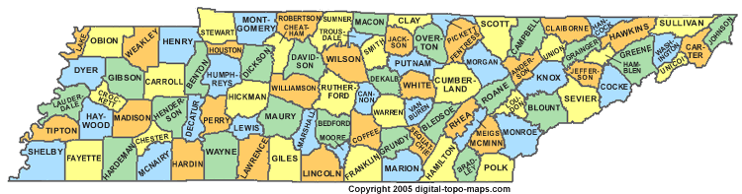
IN MOST CASES, THE COUNTY ATTORNEY REPRESENTS THE COUNTY RATHER THAN AN INDIVIDUAL GOVERNMENT EMPLOYEE OR OFFICER.
This Photo by Unknown Author is licensed under CC BY-SA

Slide 79

WHY DOES IT MATTER?
This Photo by Unknown Author is licensed under CC BY-NC-ND

Slide 80
HYPOTHETICAL 6
WHITE FIREFIGHTERS BROUGHT AN ACTION ALLEGING THAT THE CITY VIOLATED TITLE VII BY PROMOTING AN AFRICAN-AMERICAN FIREFIGHTER TO THE RANK OF CAPTAIN WITHOUT REGARD TO THE RESPECTIVE QUALIFICATIONS OF CANDIDATES.

Slide 81
CITY COUNCIL MEMBERS PARTICIPATED IN A MEETING WITH CITY ATTORNEY, CITY MANAGER, AND FIRE CHIEF AS THIRD PARTIES, NOT AS CLIENTS OF CITY ATTORNEY, AND SUCH MEETING CALLED BY A COUNCIL MEMBER IN RESPONSE TO COMPLAINTS ABOUT A FIREFIGHTER’S PROMOTION.

Slide 82

DO YOU THINK THE MEETING WAS PRIVILEGED ?
This Photo by Unknown Author is licensed under CC BY-SA-NC

Slide 83

THE DISTRICT COURT FOUND THAT IT WAS PRIVILEGED.

Slide 84
THE SIXTH CIRCUIT FOUND THAT IT WAS NOT PRIVILEGED.
THIS IS THE CASE OF REED V. BAXTER 134 F.3d 351 (6th Cir. 1998).
THE COURT FOUND THAT THE COUNCILMEN WERE NOT CLIENTS OF THE CITY ATTORNEY IN RESPECT TO THIS MEETING. BECAUSE THEY PARTICIPATED AS THIRD PARTIES AND THE MEETING WAS NOT HELD IN CONFIDENCE, THEIR DISCUSSION IS NOT SHIELDED FROM DISCLOSURE BY ATTORNEY-CLIENT PRIVILEGE.

Slide 85
CITY COUNSEL MEMBERS WERE INVESTIGATING AN EXECUTIVE DECISION BY THE CITY MANAGER HAD INTERESTS ADVERSE TO THE CITY MANAGER AND THUS WERE DEEMED NOT CLIENTS OF THE CITY ATTORNEY.
THE CITY WAS UNSUCCESSFUL IN ITS BID TO ASSERT ATTORNEY-CLIENT PRIVILEGE REGARDING A MEETING BETWEEN IT’S LAWYER AND CITY COUNCIL MEMBERS.

Slide 86

AS A County ATTORNEY HOW DO YOU ETHICALLY ADVISE THE ORGANIZATION ABOUT CONDUCT THAT MAY CREATE LEGAL RISKS FOR THE ORGANIZATION’S CONSTITUENTS ?

Slide 87
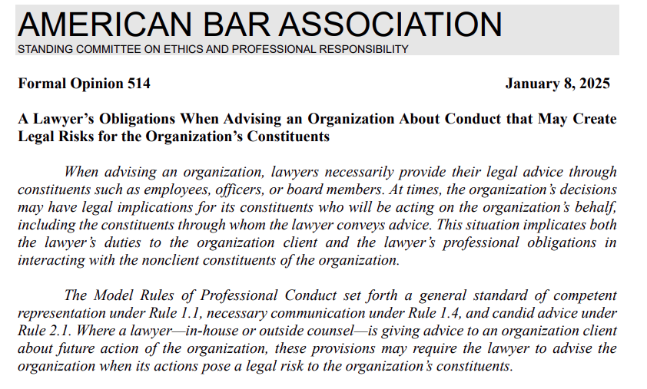

Slide 88

ETHICAL PITFALLS FOR COUNTY ATTORNEYS THAT ALSO HAVE PRIVATE CLIENTS

Slide 89

FAILURE TO MANAGE YOUR CLIENT’S EXPECTATIONS

Slide 90
MOST DISCIPLINARY COMPLAINTS ARE ROOTED IN A LAWYER’S FAILURE TO SET REASONABLE EXPECTATIONS AT THE OUTSET OF REPRESENTATION AS TO:
1. THE RESULT.
2. HOW LONG IT WILL TAKE.
3. HOW MUCH IT WILL COST.
4. HOW OFTEN THE LAWYER WILL COMMUNICATE
WITH THE CLIENT.

Slide 91

ETHICAL ISSUES FOR COUNTY ATTORNEYS WHO ALSO HAVE PRIVATE CLIENTS
COMPETENCE
CONFIDENTIALITY
CONFLICTS
COMMUNICATION

Slide 92
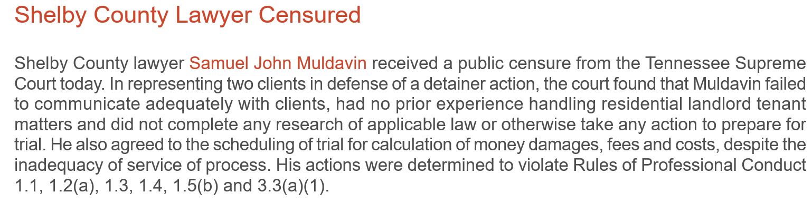

Slide 93

CONFIDENTIALITY

Slide 94

RPC 1.6
“A lawyer shall not reveal information relating to the representation of cline unless:
1. the client gives informed consent;
2. the disclosure is impliedly authorized in order to carry out the representation; or
3. the disclosure is permitted by paragraph (b) or required by paragraph (c).”

Slide 95
RPC 1.6 COMMENT [3]
“The confidentiality rule, for example, applies not only to matters communicated in confidence by the client but also to all information relating to the representation, whatever its source. A lawyer may not disclose such information except as authorized or required by the Rules of Professional Conduct or other law.”

Slide 96
MOST COMMON WAYS CONFIDENTIALITY IS BREACHED.
1. SOCIAL MEDIA
2. MOTIONS TO WITHDRAW
3. TALKING TO OTHER LAWYERS

Slide 97

BE CAREFUL NOT TO REVEAL CLIENT CONFIDENTIAL INFORMATION IN RESPONDING TO NEGATIVE ONLINE REVIEWS

Slide 98
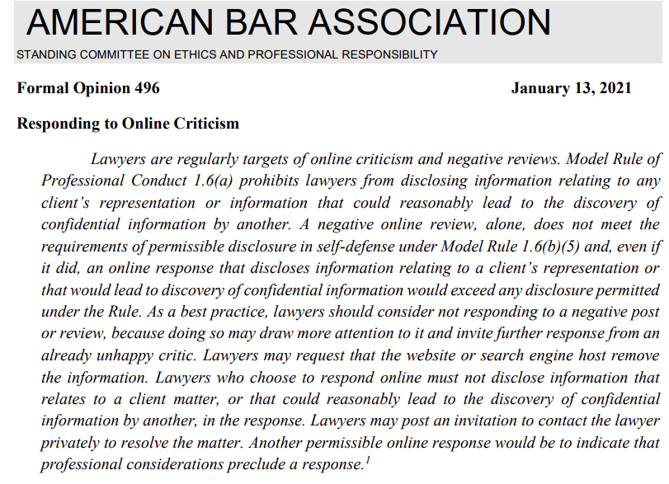
ABA FORMAL OPINION 496

Slide 99
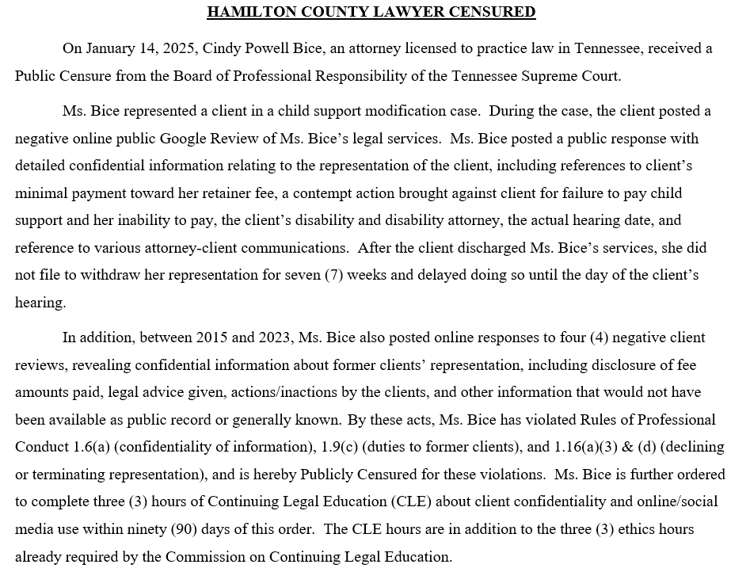

Slide 100
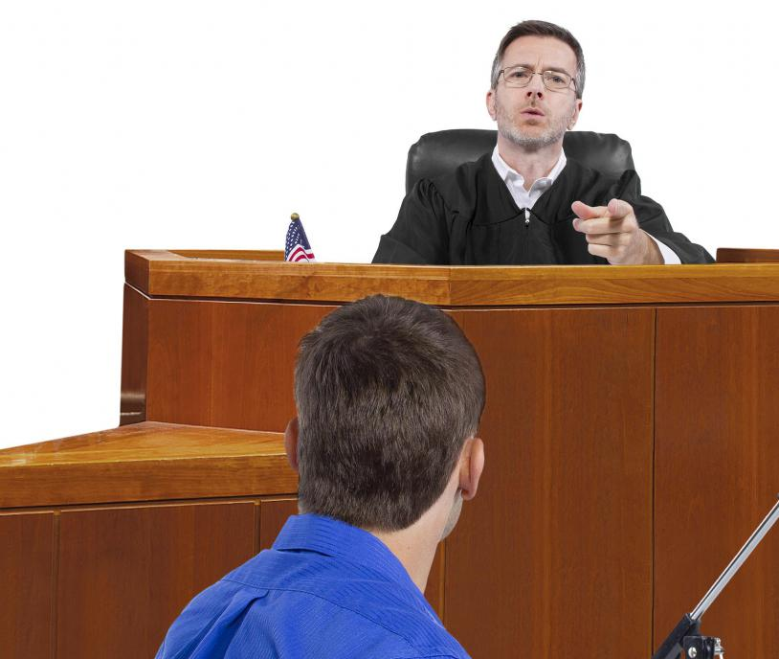
TAKE CARE NOT TO VIOLATE THE DUTY OF CONFIDENTIALTITY WHEN MOVING TO WITHDRAW FROM REPRESENTATION

Slide 101
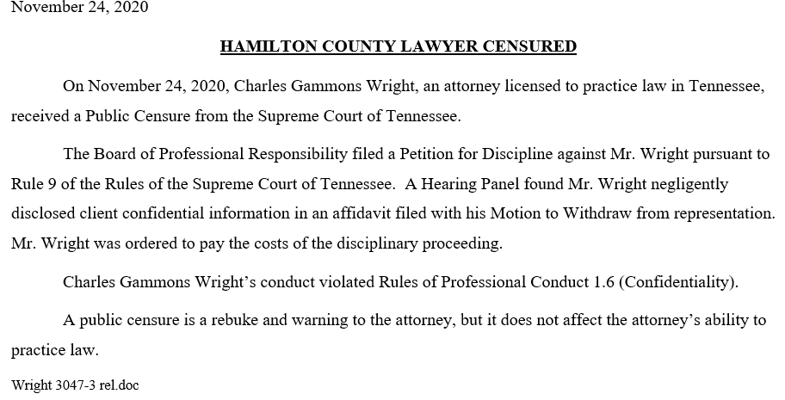

Slide 102
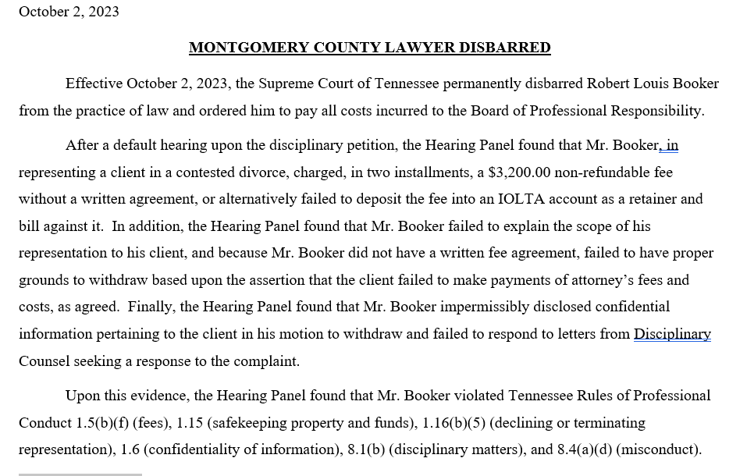

Slide 103
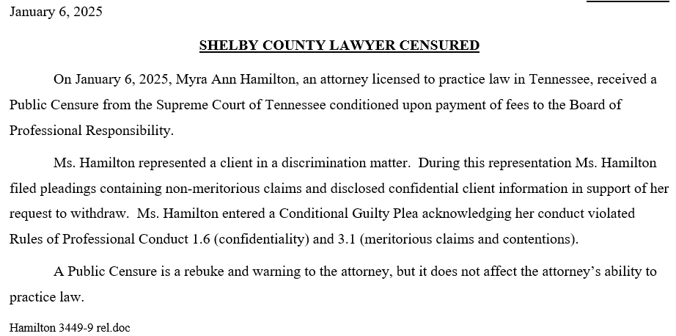

Slide 104
RPC 1.16 COMMENT [3]
“Difficulty may be encountered if withdrawal is based on the client’s demand that the lawyer engage in unprofessional conduct. The court may request an explanation for the withdrawal, while the lawyer may be bound to keep confidential the facts that would constitute such an explanation. The lawyer’s statement that professional considerations require termination of the representation ordinarily should be accepted as sufficient.”

Slide 105
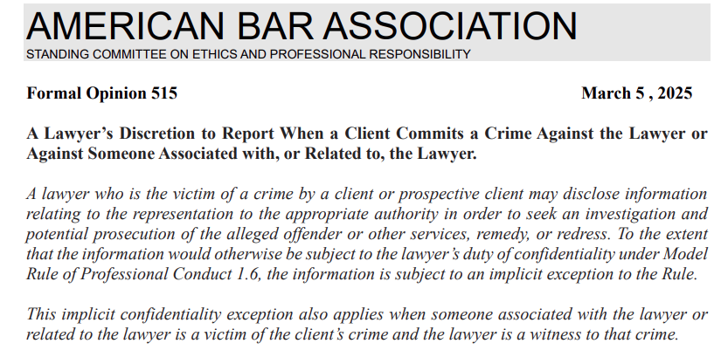
ABA FORMAL OPINION 515

Slide 106

MAINTAIN CLIENT CONFIDENTIALITY WHEN DISCUSSING CASES WITH OTHER LAWYERS

Slide 107
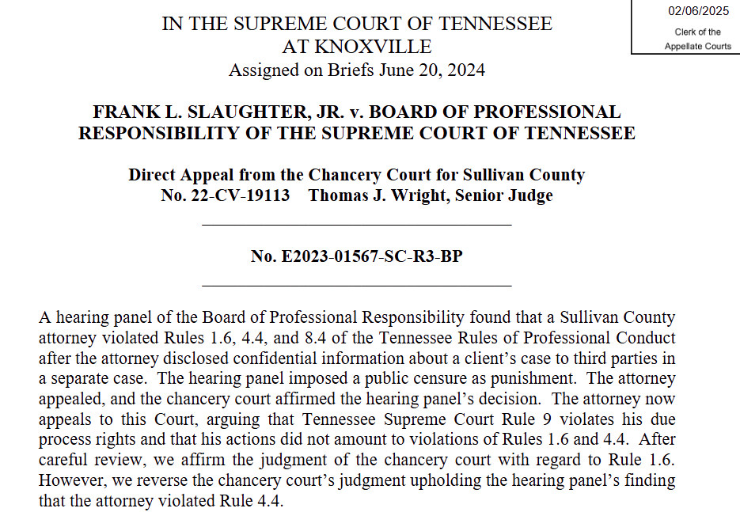

Slide 108
ABA FORMAL OPINION 515

Slide 109
CONFLICTS OF INTEREST

Slide 110
RPC 1.7(a) CONFLICTS OF INTEREST: CURRENT CLIENTS
EXCEPT AS PROVIDED IN PARAGRAPH (b), A LAWYER SHALL NOT REPRESENT A CLIENT IF THE REPRESENTATION INVOLVES A CONCURRENT CONFLICT OF INTEREST. A CONCURRENT CONFLICT OF INTEREST EXISTS IF:
1. THE REPRESENTATION OF ONE CLIENT WILL BE DIRECTLY ADVERSE TO ANOTHER CLIENT.
2. THERE IS A SIGNIFICANT RISK THAT THE REPRESENTATION OF ONE OR MORE CLIENTS WILL BE MATERIALLY LIMITED BY THE LAWYER’S RESPONSIBILITIES TO ANOTHER CLIENT, A FORMER CLIENT, OR A THIRD PERSON OR BY A PERSONAL INTEREST OF THE LAWYER.

Slide 111
A LAWYER’S DUTY TO MAINTAIN AN APPROPRIATE WORKLOAD
An unmanageable workload may create a concurrent conflict of interest under RPC 1.7(a)(2). “A concurrent conflict of interest exists if… there is a significant risk that the representation of one or more clients will be materially limited by the lawyer’s responsibilities to another client.”

Slide 112

CAN I HAVE A ROMANTIC RELATIONSHIP WITH THE CLIENT IN MY CASE ?
This Photo by Unknown Author is licensed under CC BY-NC

Slide 113
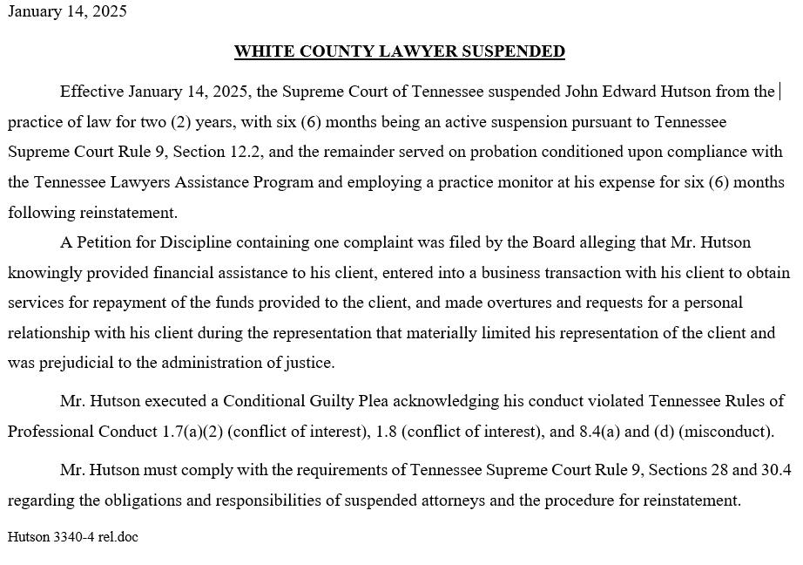

Slide 114
COMMUNICATION

Slide 115

NEGLECT FAILURE TO COMMUNICATE

Slide 116

RPC 1.4 COMMUNICATION
(a) A lawyer shall:
(1) promptly inform the client of any decision or circumstance with respect to which the client's informed consent, as defined in RPC 1.0(e), is required by these Rules;
(2) reasonably consult with the client about the means by which the client's objectives are to be accomplished;
(3) keep the client reasonably informed about the status of the matter;
(4) promptly comply with reasonable requests for information; and
(5) consult with the client about any relevant limitation on the lawyer's conduct when the lawyer knows that the client expects assistance not permitted by the Rules of Professional Conduct or other law.
(b) A lawyer shall explain a matter to the extent reasonably necessary to permit the client to make informed decisions regarding the representation
This Photo by Unknown Author is licensed under CC BY

Slide 117

RPC 1.3 DILIGENCE
A lawyer shall act with reasonable diligence and promptness in representing a client.

Slide 118
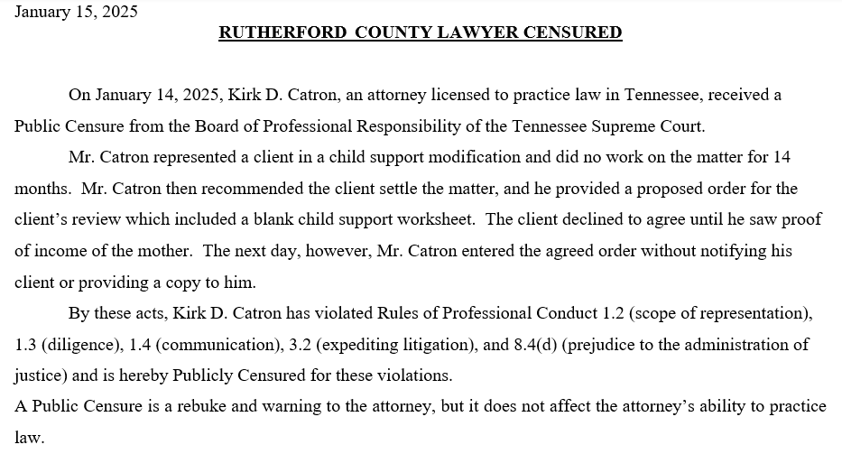

Slide 119
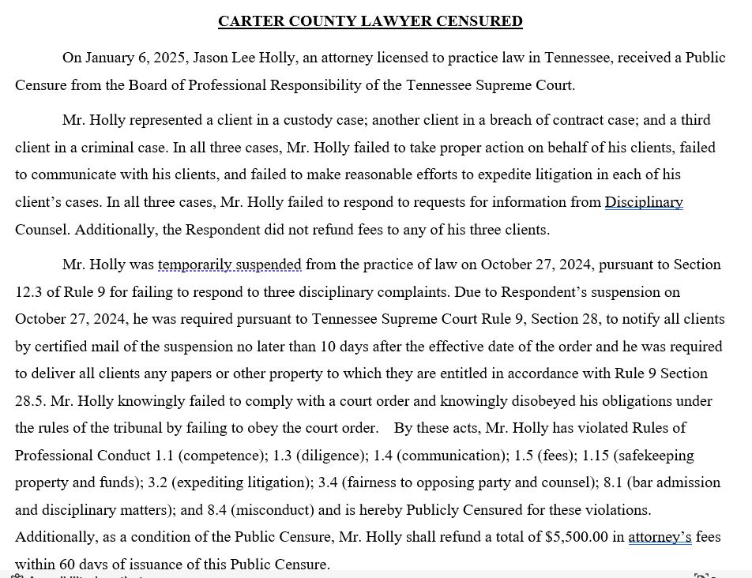

Slide 120
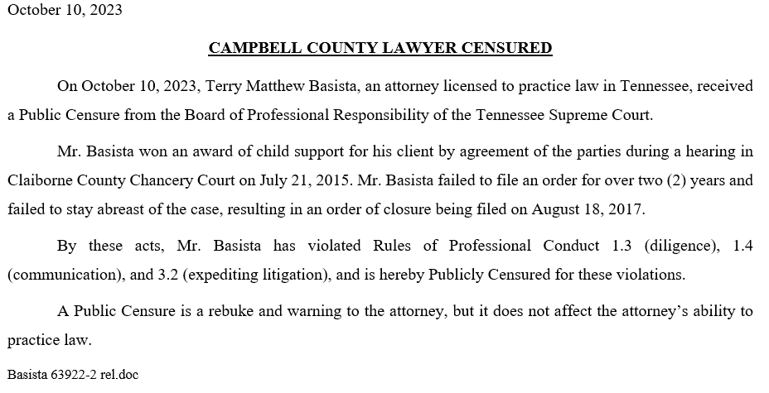

Slide 121

ETHICS UPDATE

Slide 122
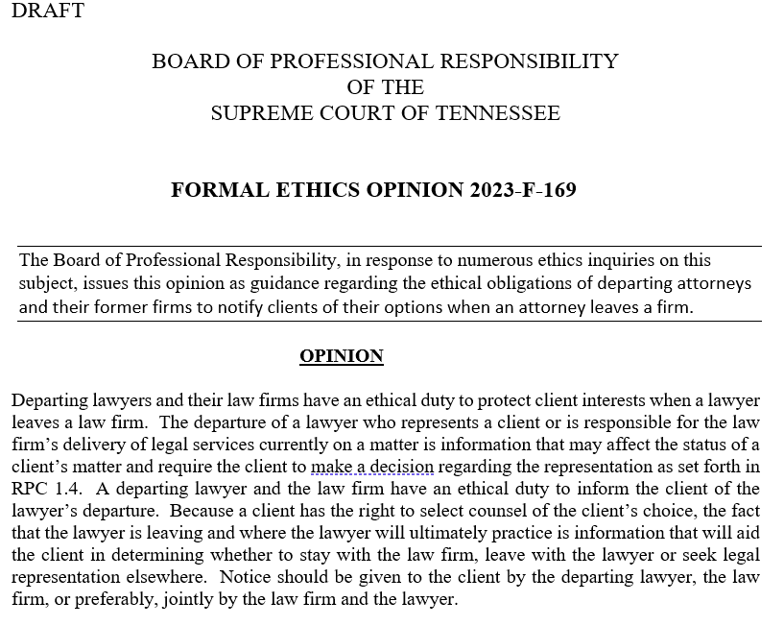
BOARD OF PROFESSIONAL RESPONSIBILITY FORMAL ETHICS OPINION 2023-F-169

Slide 123
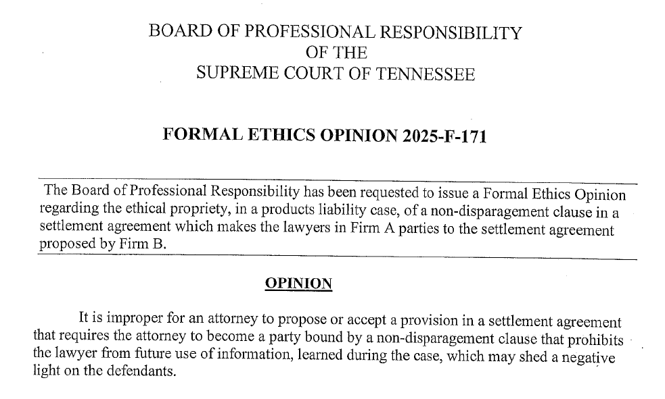
BOARD OF PROFESSIONAL RESPONSIBILITY FORMAL ETHICS OPINION 2025-F-171

Slide 124
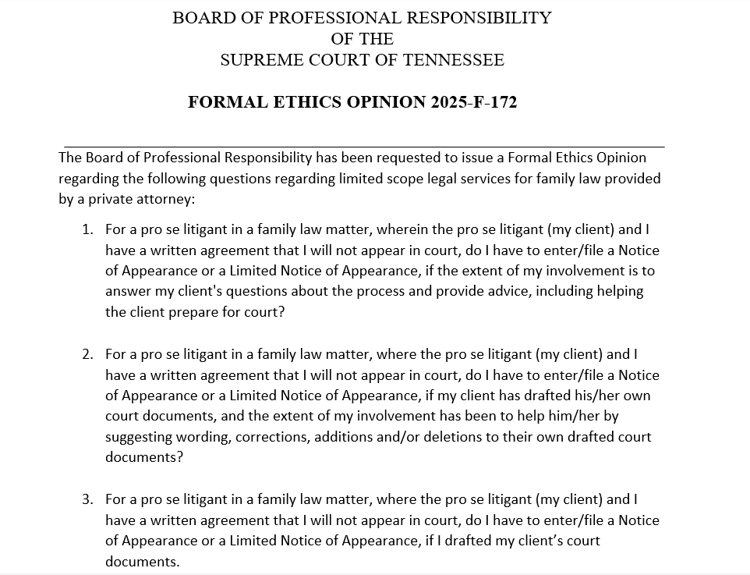
BOARD OF PROFESSIONAL RESPONSIBILITY FORMAL ETHICS OPINION 2025-F-172

Slide 125

2,367 COMPLAINTS FILED LAST YEAR
This Photo by Unknown Author is licensed under CC BY-SA

Slide 126

WHAT CAUSES CLIENTS TO FILE DISCIPLINARY COMPLAINTS ?

Slide 128

RESULTS OF INVESTIGATIONS
Administrative Dismissals: 1,371
Investigative Dismissals: 521
Diversions: 51
Private Informal Admonitions: 36
Private Reprimands: 11
Informal Public Censures: 41
Transferred to Litigation 100
Placed on Retired Status: 26
Other:11
Catholic Lawyers Guild Catholic Lawyers Guild Catholic Lawyers Guild
This Photo by Unknown Author is licensed under CC BY-NC

Slide 130

NEW SECTION TO TRUST ACCOUNT RULE

Slide 131
NEW SECTION (f) ADDED TO EXISTING TRUST ACCOUNT RULE 1.15
RPC 1.15(f) A lawyer who learns of unidentified funds in an IOLTA account must make periodic efforts to identify and return the funds to the rightful owner. If after 12 months of the discovery of the unidentified funds the lawyer determines that ascertaining the ownership or securing the return of the funds will not succeed, the lawyer must remit the funds to the Tennessee Lawyers’ Fund for Client Protection (TLFCP). No charge of ethical impropriety or other breach of professional conduct shall attend to a lawyer’s exercise of reasonable judgment under this paragraph (f).

Slide 132
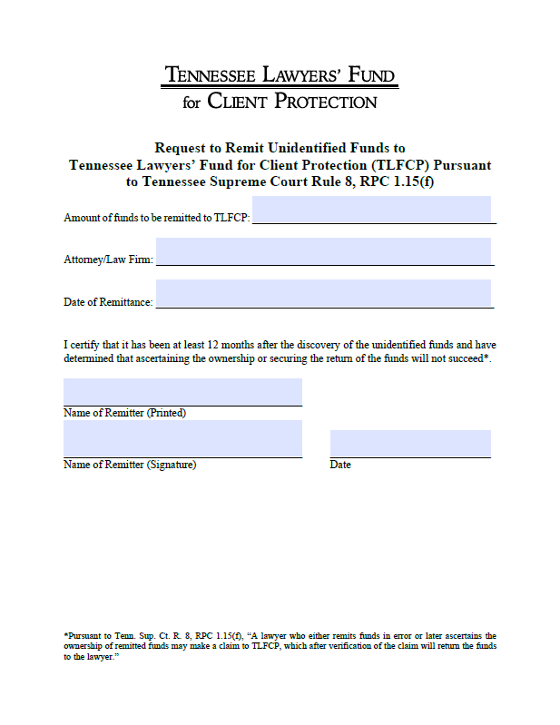
NEW FORM FOR LAWYERS’ FUND FOR CLIENT PROTECTION

Slide 133

Proactive Management-Based Regulation (PMBR)
THREE FREE ETHICS CREDITS

Slide 134
THE TEN SELF – ASSESSMENTS FOCUS ON THE TEN CORE PRACTICE PRINCIPLES
1. Developing Competent Practices.
2. Communicating in an Effective, Timely, Professional Manner.
3. Ensuring that Confidentiality Requirements are met.
4. Avoiding Conflicts of Interest.
5. Retaining and Managing Secure Files.
6. Managing the Law Firm/Legal Entity and Staff.
7. Charging Appropriate Fees and Making appropriate Disbursements.
8. Ensuring the Use of Reliable Trust Account Practices.
9. Access to Justice and Client Development; and
10. Promoting Wellness.

Slide 135
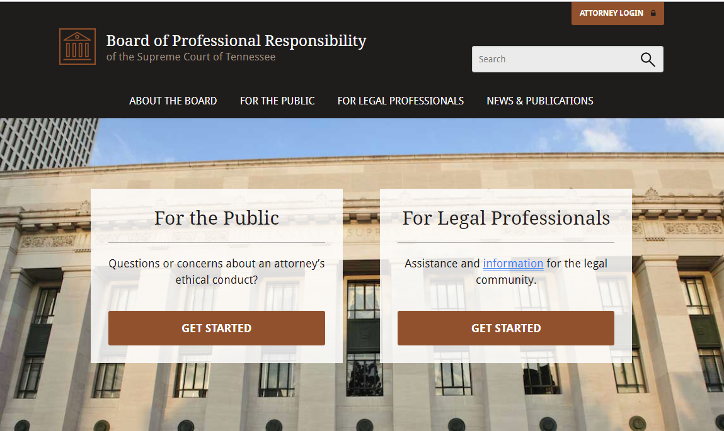

Slide 136
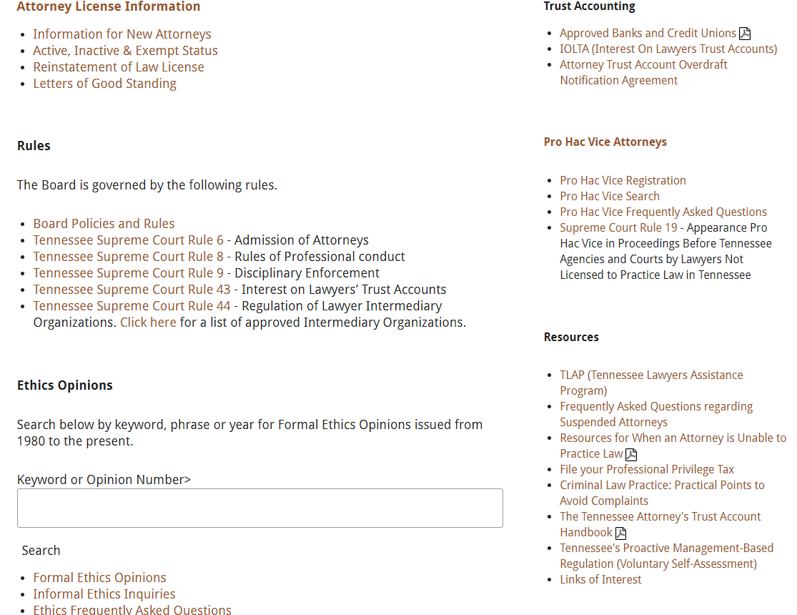

Slide 137

QUESTIONS ?
This Photo by Unknown Author is licensed under CC BY-NC-ND

Slide 138
CONTACT INFORMATION
ETHICS COUNSEL
Laura Chastain (615) 361-7500 ext. 212
lchastain@tbpr.org
Consumer Assistance Program (615) 361-7500
Tennessee Lawyers Assistance Program (615) 741-3238
Tennessee Board of Law Examiners (615) 741-3234
Tennessee Commission on Continuing Legal Education (615) 741-3096
Tennessee Board of Judicial Conduct (629-224-7482)
Tennessee Attorney General’s Office (615-741-3491)

